Slide 1


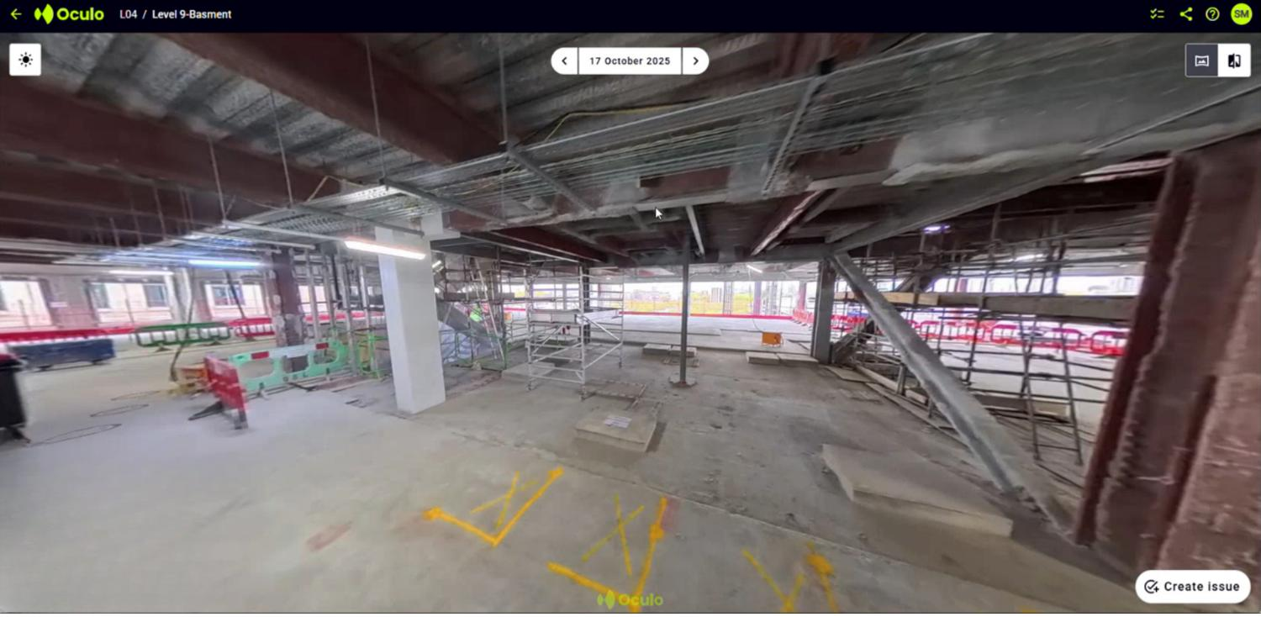
VWE: Morgan Sindall Construction – Day 3
Handout 2 – Oculo 3D scanner
On the next few pages you will see screenshots from the Oculo scanner. Your task is to use the images to compare the progress of the build between two dates. All the images you see are from the same section of the project: Level 9. The red star marks the same location in each image.
Image 1 is from 17/10/25; image 2, 3 and 4 are from 26/11/25.
IMAGE 1
Developing Experts Copyright 2026 All Rights Reserved

Slide 2
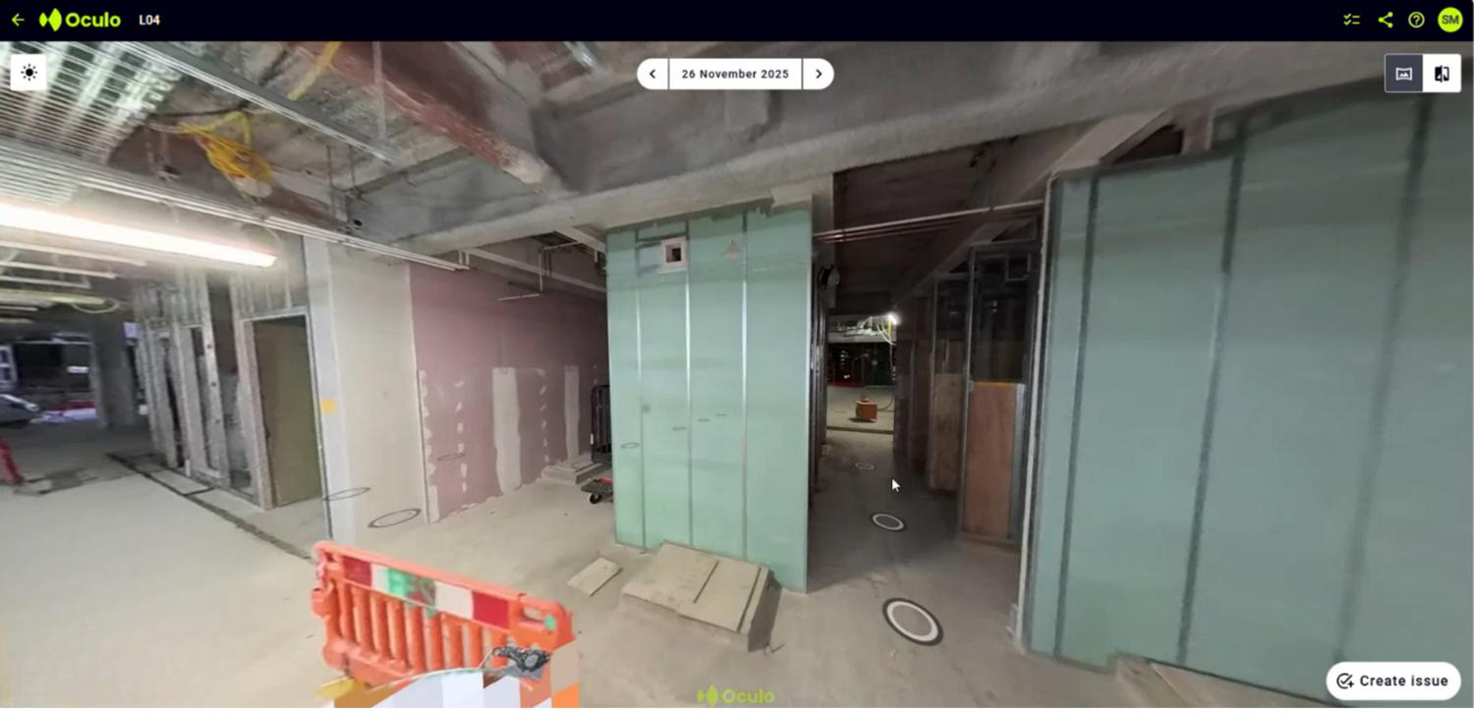
VWE: Morgan Sindall Construction – Day 3
Handout 2 – Oculo 3D scanner
IMAGE 2
Developing Experts Copyright 2026 All Rights Reserved

Slide 3
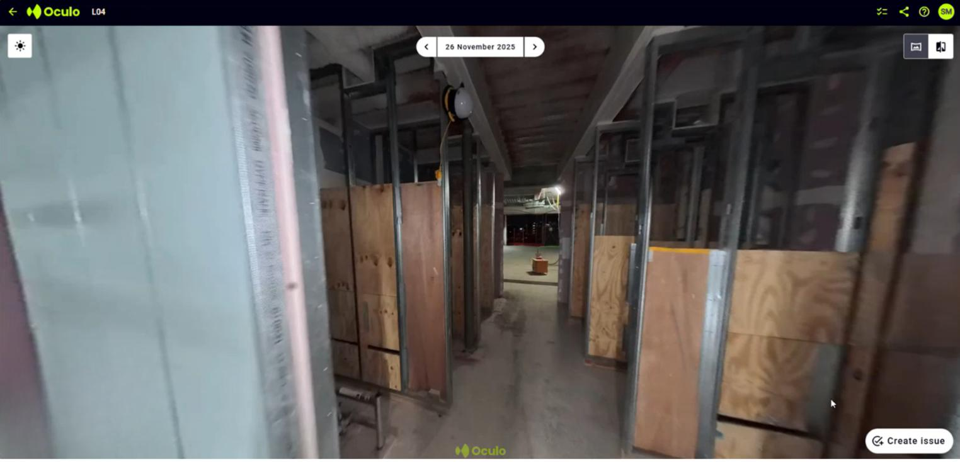
VWE: Morgan Sindall Construction – Day 3
Handout 2 – Oculo 3D scanner
IMAGE 3
Developing Experts Copyright 2026 All Rights Reserved

Slide 4
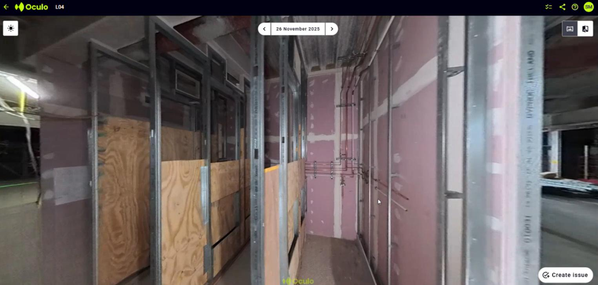
VWE: Morgan Sindall Construction – Day 3
Handout 2 – Oculo 3D scanner
IMAGE 4
Developing Experts Copyright 2026 All Rights Reserved

Slide 5
VWE: Morgan Sindall Construction – Day 3
Handout 2 – Oculo 3D scanner
How many days have passed between the first Oculo scanner image, and the other three?
_____________________
Note down all the progress you notice from October to November – imagine it like a ‘spot the difference’ activity. You could also annotate the pictures themselves. Can you see the same white pillar marked with an X in both pictures? Use that as a starting point to compare progress. Think about stud work (the framework of vertical members used to build walls, partitions, or ceilings; the skeleton of a wall before it gets covered), pipework, and plasterboard. Think as well about external walls – in which image can you see straight outside?
_________________________________________________________________________________________________________________________________________________________________________________________________________________________________________________________________________________________________________________________________________________________________________________________________________________________________________________________________________________________________________________________________________________________________________________________________________________________________________________________________________________________________________________________________________________________________________________________________________________________________________________________________________________________________________________________________________________________________________________________________________________________________________________________________________________________________________________________________________________________________________________________________________________________________________________________________________________________________________________________________________________________________________________________________________________________________________________________________________________________________________________________________________________________________________________________________________________________________________________________________________________________________________________________________________________________________________________________________________________________________________________________
Developing Experts Copyright 2026 All Rights Reserved

Slide 6
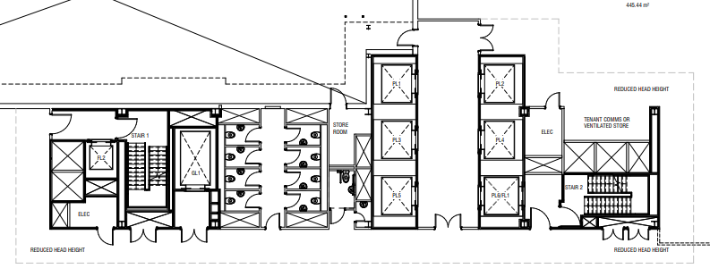
VWE: Morgan Sindall Construction – Day 3
Handout 2 – Oculo 3D scanner - Challenge
As an additional challenge, use the floor plan below to compare the images from the scanner with the floor plan for Level 9. Think back to learning how to read a floor plan in Day 1.
Look again at Image 4. Mark or highlight on the floor plan the area you think is shown in Image 4.
Can you work out what these rooms are going to be? Use the floor plan and think about the pipework!
_________________________________________________________________________________________________________
Note down here any other thoughts you have about Level 9, the progress and what next steps might be based on the floor plan. ___________________________________________________________________________________________________________________________________________________________________________________________________________________________________________________________________________________________________________________________
Developing Experts Copyright 2026 All Rights Reserved

Slide 7
VWE: Morgan Sindall Construction – Day 3
Handout 2 – Oculo 3D scanner – Challenge Answers
As an additional challenge, use the floor plan below to compare the images from the scanner with the floor plan for Level 9. Think back to learning how to read a floor plan in Day 1.
Look again at Image 4. Mark or highlight on the floor plan the area you think is shown in Image 4.
Can you work out what these rooms are going to be? Use the floor plan and think about the pipework!
Toilets/bathrooms/WCs
Note down here any other thoughts you have about Level 9, the progress and what next steps might be based on the floor plan. ___________________________________________________________________________________________________________________________________________________________________________________________________________________________________________________________________________________________________________________________
Developing Experts Copyright 2026 All Rights Reserved

