Slide 1


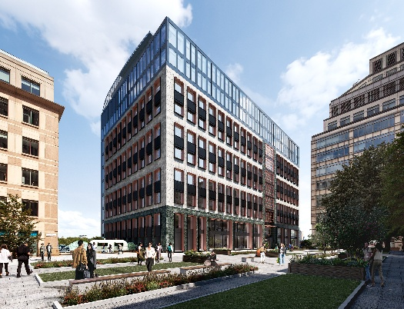
VWE: Morgan Sindall Construction – Day 1
Handout 3 – Press release
Use this information sheet for reference when preparing and creating your press release.
Key facts about the project
17 Columbus Courtyard, Canary Wharf, London
Refurbishing and extending a former (1990s) office building
To become: life-science workspaces
60% wet labs, 40% write-up and office space
To be used by researchers and growing science companies
190,000 square foot project
PC (practical completion): Summer 2026
Who will benefit from this project?
Science Companies & Startups - premium science workspaces
Researchers & Scientists - state-of-the-art lab and office facilities
Employees / Occupiers of the Building
Investors / Property Owners - higher property values and rent
Local Economy / Businesses – shops and restaurants in Canary Wharf benefit from increased footfall
Local Community & Young People - opportunities for training, work experience, and apprenticeships in construction and science; engagement programs that inspire future scientists and professionals
Job Seekers in the Local Area – new career opportunities for the local workforce
Construction & Design Teams - architects, engineers, surveyors, and contractors
Suppliers / Vendors - companies providing materials, finishes, equipment, and lab fittings
Science Community – new space to make further developments
The wider public – who knows what the research and developments discovered at these science labs might bring?
Can you think of any other individuals or groups who this project will benefit?
Developing Experts Copyright 2026 All Rights Reserved

Slide 2
VWE: Morgan Sindall Construction – Day 1
Handout 3 – Press release
Use the checklist below to create your press release designed for social media. You can design this using a medium of your choice, for example on paper or using a laptop or iPad.
Press Release Writing Checklist
Wording:
Catchy title
Key dates
Key locations
Information paragraph - Who? What? When? Where? Why?
Extra details – highlight here the impact of this project
A quote - from the client, or someone in the local community
Professional, simple language (no slang)
A link or contact for further information
Include hashtags to increase visibility on platforms
Morgan Sindall values/branding
Correct spelling/grammar
  Imagery:
Visuals of the project or the location
An infographic (for example a map, a timeline or a graph)
  Links to websites
Developing Experts Copyright 2026 All Rights Reserved

Slide 3
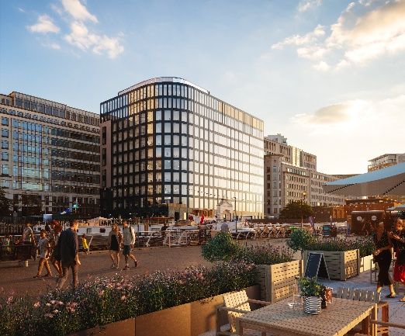
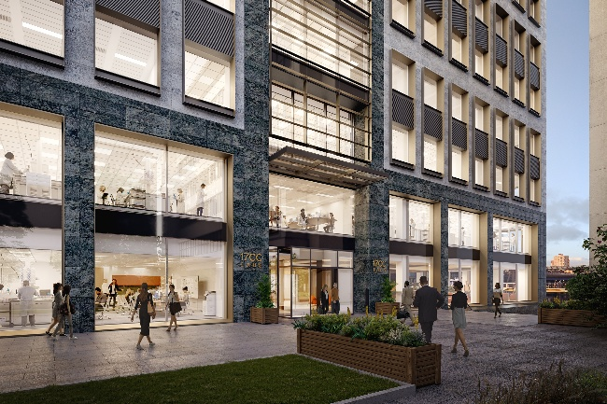
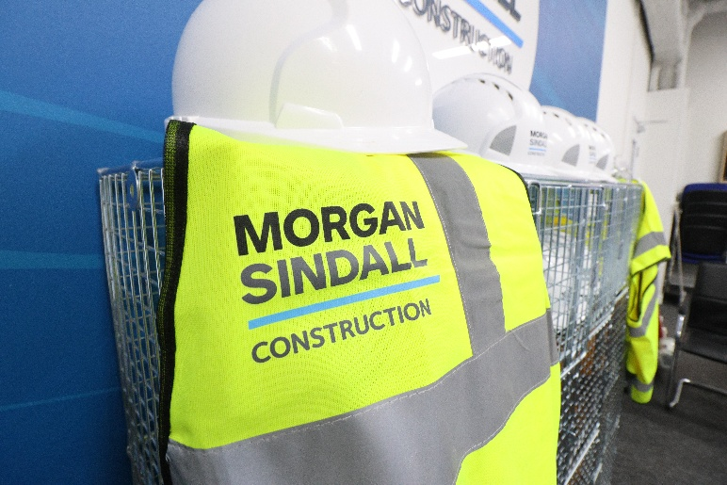

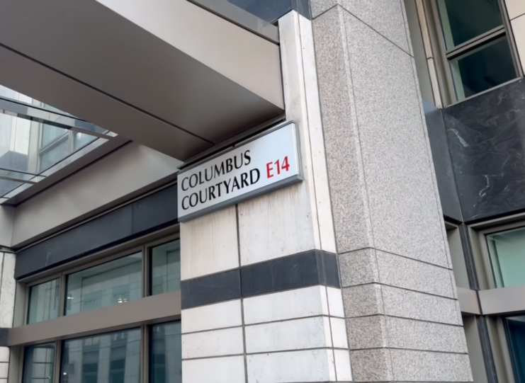
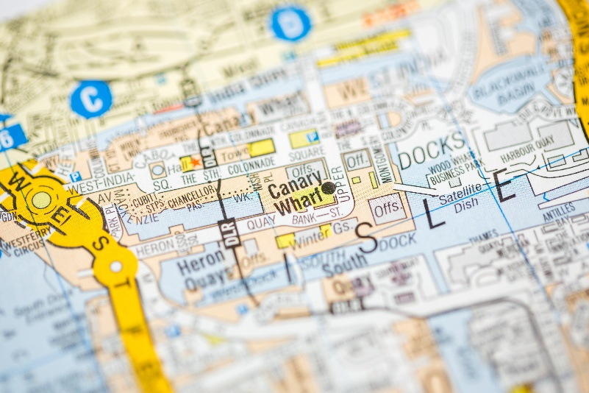
VWE: Morgan Sindall Construction – Day 1
Handout 3 – Press release
Here are some images that you can use in your press release.
Developing Experts Copyright 2026 All Rights Reserved

