Slide 1

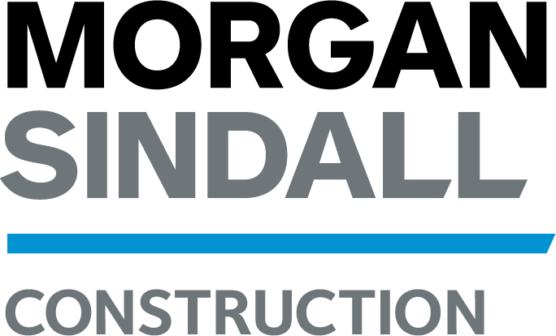
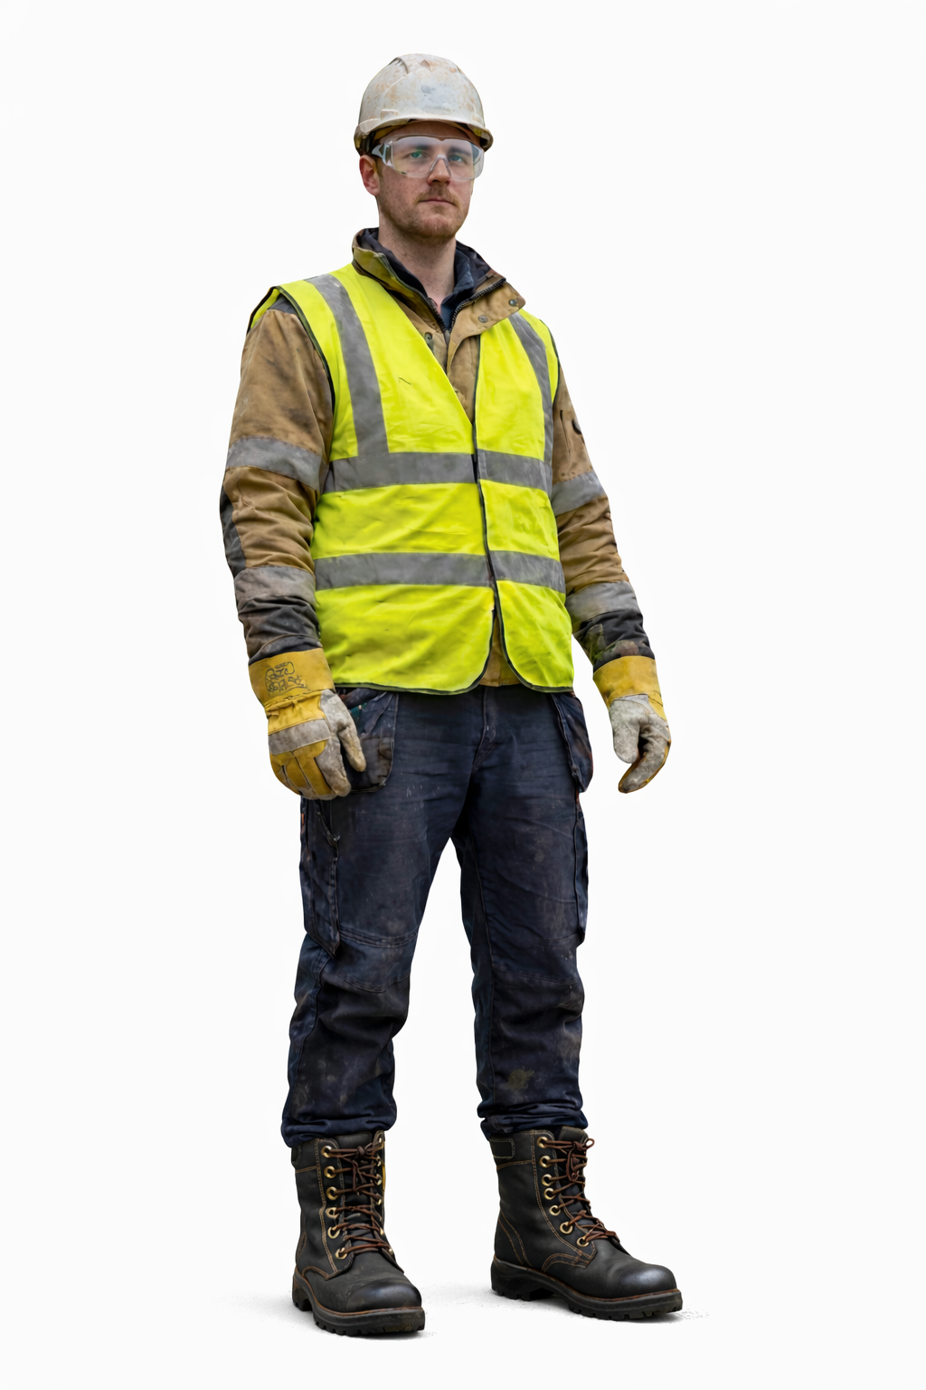
VWE: Morgan Sindall Construction – Day 2
Handout 3 – PPE
Label the 5-point PPE in this drawing. Use the boxes to explain what each part of the PPE does and why it is important.
Developing Experts Copyright 2026 All Rights Reserved

Slide 2
VWE: Morgan Sindall Construction – Day 2
Handout 3 – PPE
Answer the following questions about PPE.
True or False:
A high-visibility vest is used to make workers more noticeable to others on a site. __________
Gloves are only needed when handling chemicals. ___________
Safety boots protect your feet from heavy objects. ___________
Jamie is working on a construction site. He needs to cut metal pipes, which could produce sparks and flying metal pieces. Which PPE items should Jamie wear in addition to the 5-point PPE?
__________________________________________________________________
Why is it important to wear task-specific PPE even if you are already wearing the 5-point PPE?
_____________________________________________________________________________________________________________________________________________________________________________________________________
A student work-experience group is visiting a construction site where drilling and cutting work is taking place. One student is wearing a hard hat, high-visibility vest, gloves, and safety boots, but no eye or ear protection.
4a. What risks is the student exposed to?
___________________________________________________________________________________________________________________________________
4b. What PPE is missing and how could wearing it reduce the risk of injury?
____________________________________________________________________________________________________________________________________
Who do you think is responsible for ensuring that workers wear PPE on a construction site and why?
____________________________________________________________________________________________________________________________________
PPE isn’t only used in construction. Give three examples of PPE used outside construction. Think about sports, healthcare or home DIY projects.
____________________________________________________________________________________________________________________________________
Developing Experts Copyright 2026 All Rights Reserved

Slide 3
VWE: Morgan Sindall Construction – Day 2
Handout 3 – PPE Answers
Answer the following questions about PPE.
True or False:
A high-visibility vest is used to make workers more noticeable to others on a site. True
Gloves are only needed when handling chemicals. False
Safety boots protect your feet from heavy objects. True
Jamie is working on a construction site. He needs to cut metal pipes, which could produce sparks and flying metal pieces. Which PPE items should Jamie wear in addition to the 5-point PPE?
Ideas include: Face shield (protects the face from sparks and flying metal), hearing protection (cutting metal can be loud and damage hearing) and long-sleeved flame-resistant clothing (to protect skin from sparks).
Why is it important to wear task-specific PPE even if you are already wearing the 5-point PPE?
Sample answer: The 5-point PPE provides general protection, but task-specific PPE protects against hazards unique to certain activities. For example, cutting metal may produce sparks that can burn the skin or damage the eyes, so additional protection like a face shield or flame-resistant clothing is necessary.
A student work-experience group is visiting a construction site where drilling and cutting work is taking place. One student is wearing a hard hat, high-visibility vest, gloves, and safety boots, but no eye or ear protection.
4a. What risks is the student exposed to?
Ideas include: Eye injuries from flying debris, dust, or sparks. Hearing damage from loud drilling or cutting equipment.
4b. What PPE is missing and how could wearing it reduce the risk of injury?
Safety goggles or a face shield would protect the eyes from debris and sparks. Ear protection would prevent hearing damage from loud noise.
Who do you think is responsible for ensuring that workers wear PPE on a construction site and why?
Answers may vary but should explain that it is everybody’s responsibility to ensure workers are safe.
PPE isn’t only used in construction. Give three examples of PPE used outside construction. Think about sports, healthcare or home DIY projects.
Answers may vary.
Developing Experts Copyright 2026 All Rights Reserved

