Slide 1


Rackheath Vets Virtual Work Experience
Module 1: Introduction to animal care careers
What do you want to learn?
Mission Assignment: What is the equator?
Session 2
Code: GEO-13-04
Think about what you hope to get out of the experience at Rackheath Vets.
Write down two things you’d like to learn or improve during your time with us.
Here are some ideas to help you get started:
  Working better as part of a team
  Talking more clearly to others
  Feeling more confident around animals
  Learning how a real vet practice work
I hope to learn…
2. I’d like to improve…
Developing Experts Copyright 2025 All Rights Reserved
Developing Experts Copyright 2024 All Rights Reserved

Slide 2
Rackheath Vets Virtual Work Experience
Module 1: Introduction to animal care careers
Meet the team
Mission Assignment: What is the equator?
Session 2
Code: GEO-13-04
Use this space to make notes after watching the meet the team video.
1. Who are the different people you met in the video, and what are their roles?
________________________________________________________________________________________________________________________________________________________________________________________________________________________________________________
2. Which area of the practice would you most like to work in, and why?
________________________________________________________________________________________________________________________________________________________________________________________________________________________________________________
3. Did anything surprise you about how a vet practice looks or works?
________________________________________________________________________________________________________________________________________________________________________________________________________________________________________________
Developing Experts Copyright 2025 All Rights Reserved
Developing Experts Copyright 2024 All Rights Reserved

Slide 3

Rackheath Vets Virtual Work Experience
Module 1: Introduction to animal care careers
Writing a job description
Mission Assignment: What is the equator?
Session 2
Code: GEO-13-04
As you watch Teresa, Chris, Piene and Jackie explain their roles at the practice, use the space below to make notes.
Notes ____________________________________________________________________________________________________________________________________________________________________________________________________________________________________________________________________________________________________________________________________________________________________________________________________________________________________________________________________________________________________________________________________________________________________________________________________________________________________________________________________________________________________________________________________________________________________________________________________________________________________________________________________________________________________________________________________________________________________________________________________________________________________________________________________________________
Developing Experts Copyright 2025 All Rights Reserved
Developing Experts Copyright 2024 All Rights Reserved

Slide 4
Rackheath Vets Virtual Work Experience
Module 1: Introduction to animal care careers
Writing a job description
Mission Assignment: What is the equator?
Session 2
Code: GEO-13-04
Use the template below to create a job description for one of the four roles you have learnt about at Rackheath Vets.
Job title:
(What is the job called?)
Reports to:
(Who would be their manager?)
Role overview:
(Summarise the role)
Key responsibilities:
(What are the main things this person will do every day?)
• __________________________________________________
• __________________________________________________
• __________________________________________________
Skills & personal attributes:
(What kind of person would be good at this job?)
________________________________________________________________________________________________________________________________________________________________________________________________________________________
Why this role is important at Rackheath Vets:
(How does this job help animals and the team?)
________________________________________________________________________________________________________________________________________________________________________________________________________________________
Developing Experts Copyright 2025 All Rights Reserved
Developing Experts Copyright 2024 All Rights Reserved

Slide 5
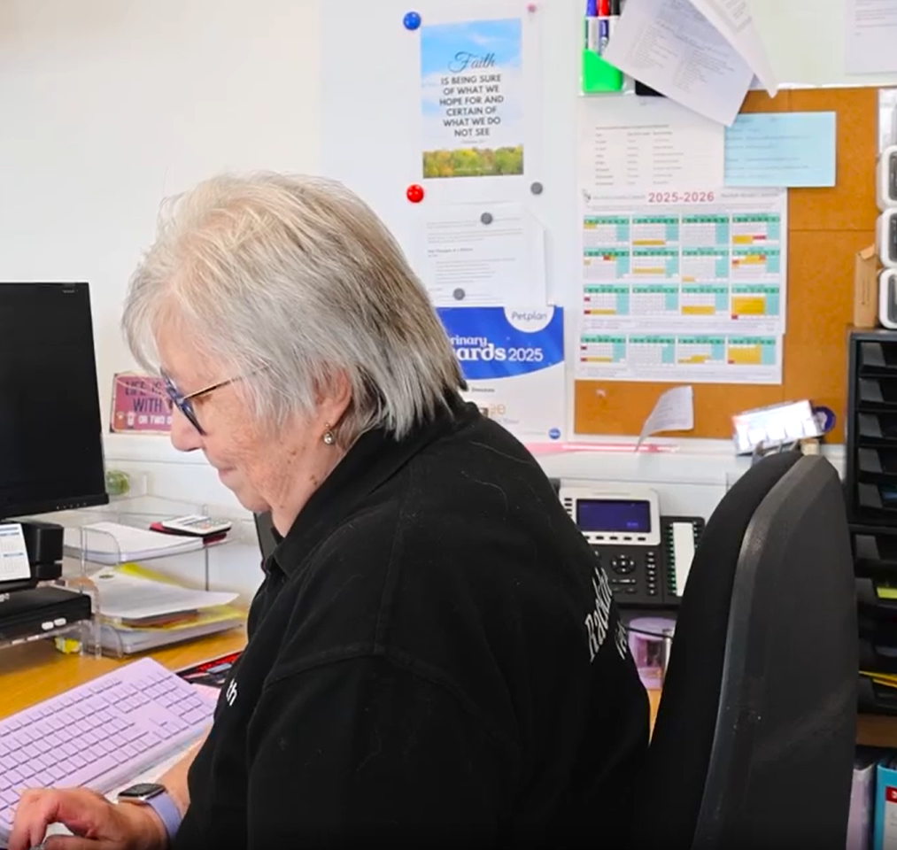
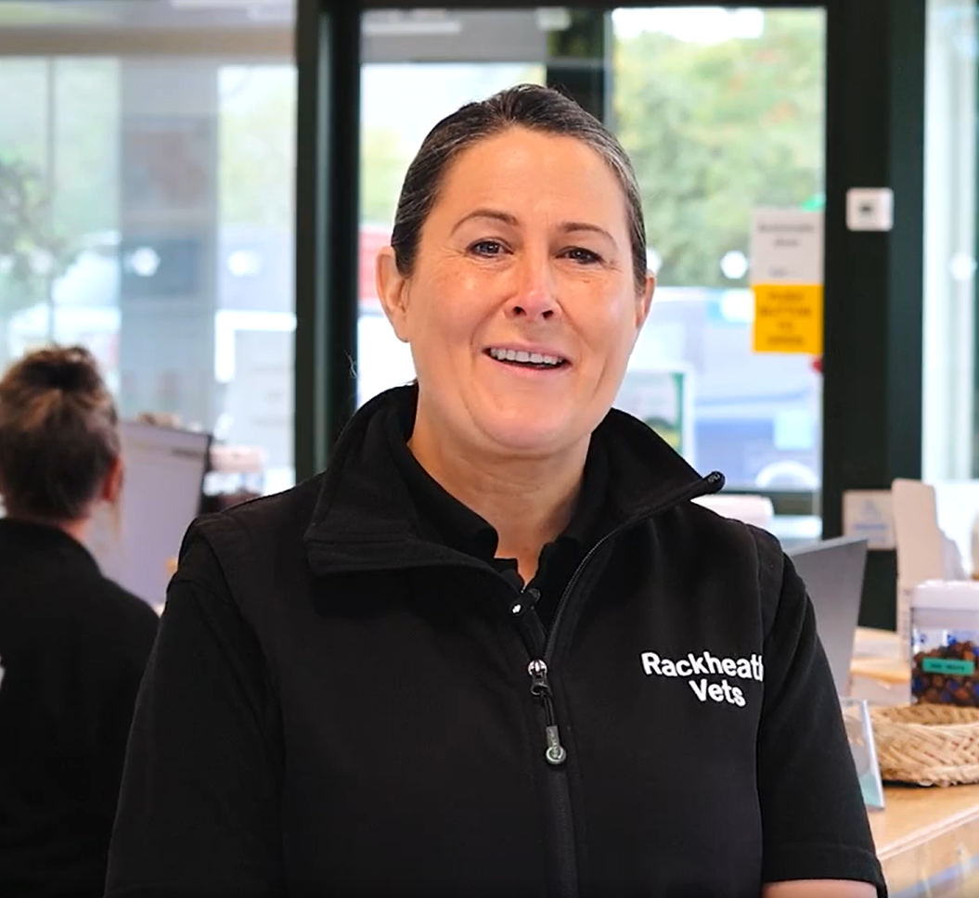
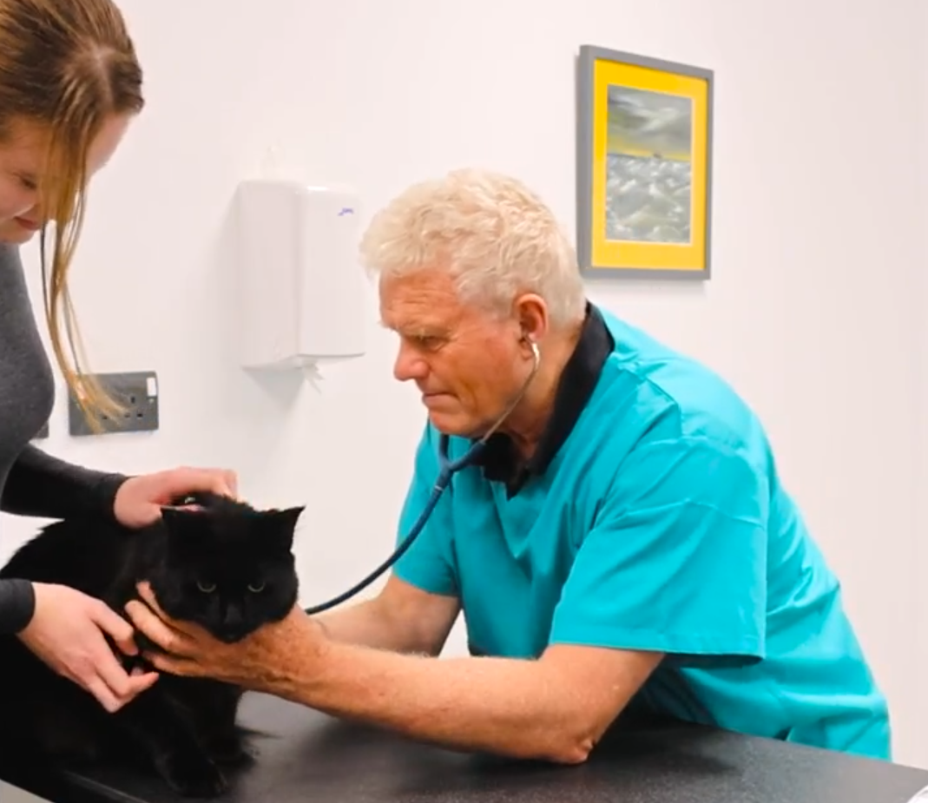
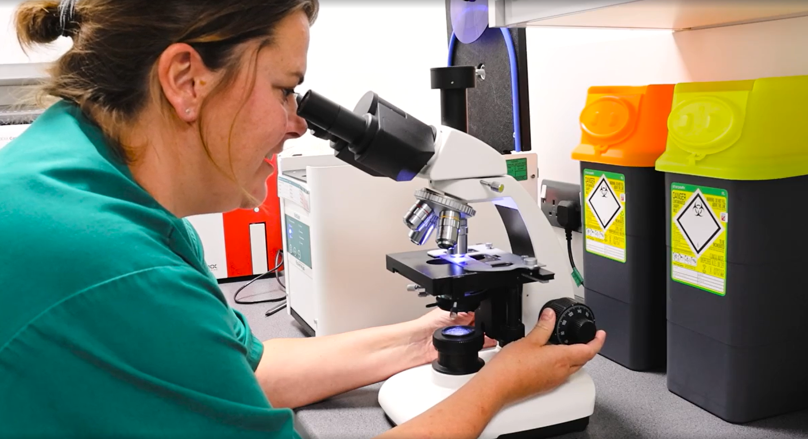
Rackheath Vets Virtual Work Experience
Module 1: Introduction to animal care careers
Working as a team
Mission Assignment: What is the equator?
Session 2
Code: GEO-13-04
Match the task to the team member.
Jackie
Practice Manager
Teresa
Receptionist
Chris
Veterinary Surgeon
Piene
Veterinary Nurse
Greet pet owners when they arrive and answer the phone calls.
Who does this?
Oversee staff
schedules and
order supplies
for the practice.
Who does this?
Help owners fill out forms and explain practice rules.
Who does this?
Prepare and give medicine to animals after their treatment.
Who does this?
Book appointments and update the schedule for the vets.
Who does this?
Clean up
animal messes
in reception
and monitor
areas.
Who does this?
Perform health checks and operations on sick or injured animals.
Who does this?
Help animals feel calm and comfortable before and after surgery.
Who does this?
Check vital signs like heart rate and temperature before treatment.
Who does this?
Assist the vet
during surgery
or medical
procedures.
Who does this?
Developing Experts Copyright 2025 All Rights Reserved
Developing Experts Copyright 2024 All Rights Reserved

Slide 6
Rackheath Vets Virtual Work Experience
Module 1: Introduction to animal care careers
Match the professionals to their tools
Mission Assignment: What is the equator?
Session 2
Code: GEO-13-04
As you watch Teresa, Chris, Piene and Jackie explain which tools and equipment they use in their roles, use the space below to make notes.
Teresa, Receptionist-________________________________________________________________________________________________________________________________________________________________________________________________________________________________________
Chris, Veterinary Surgeon
________________________________________________________________________________________________________________________________________________________________________________________________________________________________________
Piene, Veterinary Nurse ________________________________________________________________________________________________________________________________________________________________________________________________________________________________________
Jackie, Practice Manager ________________________________________________________________________________________________________________________________________________________________________________________________________________________________________
Developing Experts Copyright 2025 All Rights Reserved
Developing Experts Copyright 2024 All Rights Reserved

Slide 7


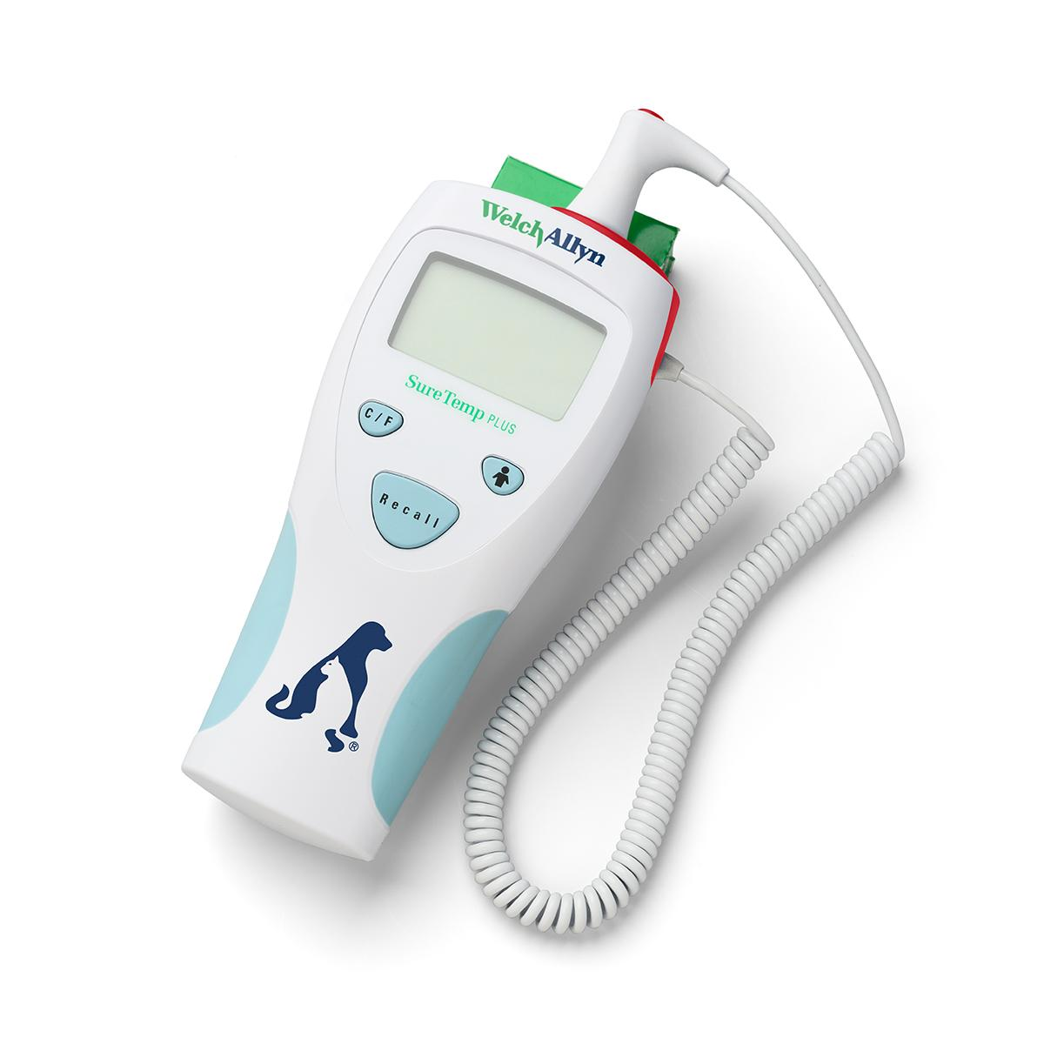



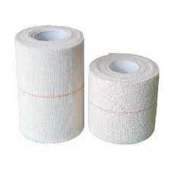

Rackheath Vets Virtual Work Experience
Module 1: Introduction to animal care careers
Match the professionals to their tools
Mission Assignment: What is the equator?
Match each team member with the tools they use in their daily tasks.
Session 2
Code: GEO-13-04
Jackie
Practice Manager
Teresa
Receptionist
Chris
Veterinary Surgeon
Piene
Veterinary Nurse
syringe
stethoscope
telephone
thermometer
appointment book
food bowl
bandages
cleaning equipment
Developing Experts Copyright 2025 All Rights Reserved
Developing Experts Copyright 2024 All Rights Reserved

Slide 8
Rackheath Vets Virtual Work Experience
Module 1: Introduction to animal care careers
Spotlight role – Veterinary Nurse
Mission Assignment: What is the equator?
Session 2
Code: GEO-13-04
You are helping a nervous cat who has just arrived at the vet practice. He’s shaking, hiding behind his owner, and looking very worried. What can you do to help him feel calm and safe?
Step 1: What would you do first?
________________________________________________________________________________________________________________________________________________________________________________________________________________________________________
Step 2: What would help the cat to feel more relaxed in the room? ________________________________________________________________________________________________________________________________________________________________________________________________________________________________________
Step 3: How do you keep the cat calm whilst waiting for the vet? ________________________________________________________________________________________________________________________________________________________________________________________________________________________________________
Developing Experts Copyright 2025 All Rights Reserved
Developing Experts Copyright 2024 All Rights Reserved

Slide 9
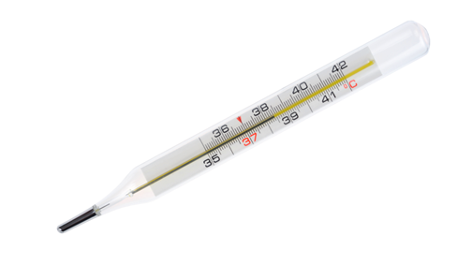
Rackheath Vets Virtual Work Experience
Module 1: Introduction to animal care careers
Spotlight role – Veterinary Surgeon
Mission Assignment: What is the equator?
Session 2
Code: GEO-13-04
Take the pet’s temperature and complete a health check-up for a cat.
Temperature reading ____________
Write out the steps needed to complete a health check on a cat.
You can go back to the video and watch Chris again if you need any reminders
For each step, think about what the vet should check and what equipment should be used:
Step 1: _______________________________________________
Equipment needed: ____________________________________
Step 2: _______________________________________________
Equipment needed: ____________________________________
Step 3: _______________________________________________
Equipment needed: ____________________________________
Step 4: _______________________________________________
Equipment needed: ____________________________________
Developing Experts Copyright 2025 All Rights Reserved
Developing Experts Copyright 2024 All Rights Reserved

Slide 10

Rackheath Vets Virtual Work Experience
Module 1: Introduction to animal care careers
Spotlight role – Receptionist
Mission Assignment: What is the equator?
Session 2
Code: GEO-13-04
Book the client’s appointment and write a confirmation email.
Which appointments would suit the customer? Circle all the ones that apply.
Tuesday 10th February 9:30am
Wednesday 11th February 4:15pm
Thursday 12th February 1pm
Friday 13th February 2:30pm
Saturday 14th February 10:30am
Monday 23rd February 5pm
Write a confirmation email to the customer confirming one of the appointment times you chose. Remember to include the recipient's email address and a subject.
____________________________________________________________________________________________________________________________________________________________________________________________________________________________________________________________________________________________________________________________________________________________________________________________________________________________________________________________________________________________________________________________________________________________________________________________________________________________________________________________________________________
Developing Experts Copyright 2025 All Rights Reserved
Developing Experts Copyright 2024 All Rights Reserved

Slide 11
Rackheath Vets Virtual Work Experience
Module 1: Introduction to animal care careers
Reflection activity: Which role is right for you?
Mission Assignment: What is the equator?
Session 2
Code: GEO-13-04
Answer the questions below to reflect on which role would best suit you. Look back at the job description you wrote earlier and think about your own skills, interests and personality.
1. Which role do you think you would enjoy the most?
__________________________________________________________
2. Why do you think you’d be good at it?
______________________________________________________________________________________________________________________________________________________________________________
3. What qualities or experiences do you have that would help you?
______________________________________________________________________________________________________________________________________________________________________________
4. Write a short paragraph explaining your choice. You might start like this: “I think I would be a good Veterinary Nurse because I am caring and calm. I’ve looked after my neighbour’s dog before and I like helping others.”
____________________________________________________________________________________________________________________________________________________________________________________________________________________________________________________________________________________________________________________________________________________________________________________________________________
Developing Experts Copyright 2025 All Rights Reserved
Developing Experts Copyright 2024 All Rights Reserved

Slide 12
Rackheath Vets Virtual Work Experience
Module 1: Introduction to animal care careers
Careers investigator
Mission Assignment: What is the equator?
Session 2
Code: GEO-13-04
Reflect on what you have found out using the AI tool.
1. Which role did you find out more about?
__________________________________________________________
2. What do you like about this role?
______________________________________________________________________________________________________________________________________________________________________________
3. What surprised you?
______________________________________________________________________________________________________________________________________________________________________________
4. Can you see yourself doing this job in the future?
__________________________________________________________________________________________________________________________________________________________________________________________________________________________________________________________________________________________________
Developing Experts Copyright 2025 All Rights Reserved
Developing Experts Copyright 2024 All Rights Reserved

Slide 13
Rackheath Vets Virtual Work Experience
Module 1: Introduction to animal care careers
Closing webinar
Mission Assignment: What is the equator?
Session 2
Code: GEO-13-04
Reflect on what your work experience day at Rackheath
1. Which of the four roles did you find most interesting and why?
__________________________________________________________
2. Which of the key skills do you think is most important in animal care?
______________________________________________________________________________________________________________________________________________________________________________
3. Can you think of a time you used one of these skills? (At school, at home, or with a pet?) ______________________________________________________________________________________________________________________________________________________________________________
Developing Experts Copyright 2025 All Rights Reserved
Developing Experts Copyright 2024 All Rights Reserved

Slide 14
Rackheath Vets Virtual Work Experience
Module 1: Introduction to animal care careers
Look back: What did you learn?
Mission Assignment: What is the equator?
Session 2
Code: GEO-13-04
Go back to the goals you set yourself at the start of the day
1. Did you achieve the goals you set for yourself?
__________________________________________________________
2. Did you learn something new or unexpected?
______________________________________________________________________________________________________________________________________________________________________________
3.Do you have any further questions you’d like to find out?
______________________________________________________________________________________________________________________________________________________________________________
Developing Experts Copyright 2025 All Rights Reserved
Developing Experts Copyright 2024 All Rights Reserved

