Slide 1


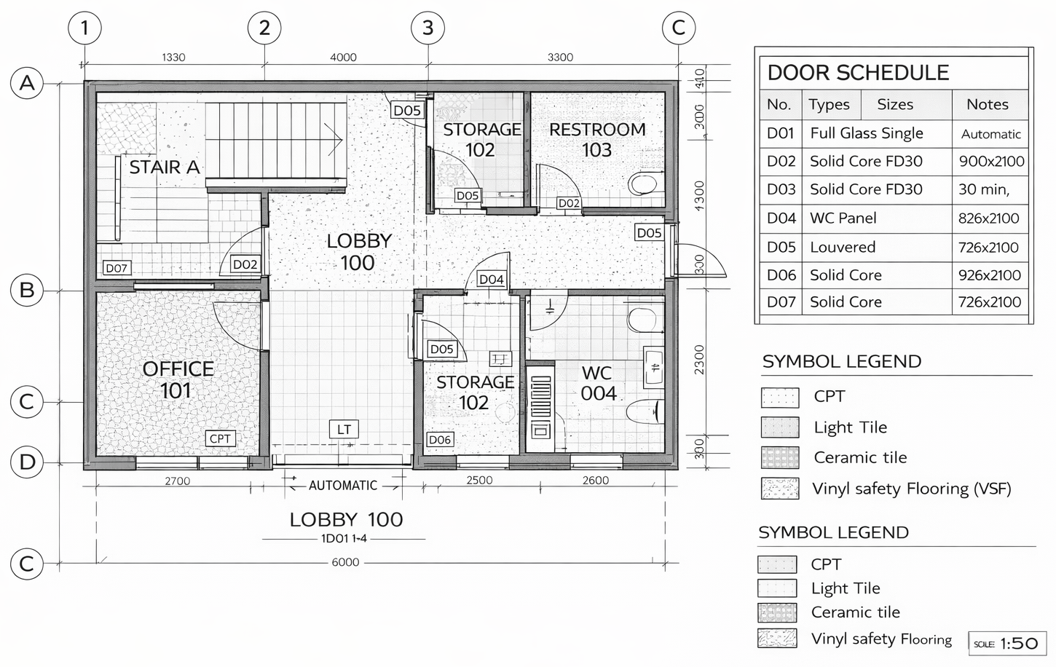
VWE: Morgan Sindall Construction – Day 1
Handout 4 – Design Manager task
Here is the drawing you will read and create a scope mark-up for. Use the next page to guide you.
Developing Experts Copyright 2026 All Rights Reserved

Slide 2

VWE: Morgan Sindall Construction – Day 1
Handout 4 – Design Manager task
Answer the following questions and annotate the drawing using the instructions below.
Reading a drawing
How many doors are there on the drawing? ____________
How many doors does restroom 103 have? ____________
What is the code for all WC panel doors? ____________
What are the measurements for all D05 doors? _____________________
Where does door D01 lead to? Use the door schedule to help you. _________________________________
What is different about door D01 compared to the other doors? _________________________________________________________ ______________________________________________________________________________________________________________________
Doors are drawn in this shape on an architectural drawing: Can you explain why this might be? ______________________________________________________________________________________________________________________ ______________________________________________________________________________________________________________________
Why would the type of flooring be relevant on an architectural drawing about doors? _____________________________________ ______________________________________________________________________________________________________________________
Scope mark-up
The subcontractor’s scope is the work that they are responsible for on a project. Your job as a Design Manager is to send a marked-up drawing to your subcontractor, showing exactly what work they are responsible for. This subcontractor is responsible for making all internal doors on this floor, excluding those made of glass. A separate subcontractor will be making all parts, including the doors, of the restroom and WC, so they are excluded too. You need to mark-up the drawing to send to the subcontractor. You can highlight, circle or box the doors they are responsible for. You will also need to add notes and make clear exactly what you expect, for example, the measurements of each door. You need to clearly mark all doors that are not in their scope, too. You could do this by using a different colour, or label as, ‘By others’. You need to be creative and clear in how you complete this task. You can add arrows and boxes to the drawing. Be as detailed as you can. For example, can you find a way to highlight the type of flooring each door must be compatible with?
Developing Experts Copyright 2026 All Rights Reserved

