Slide 1


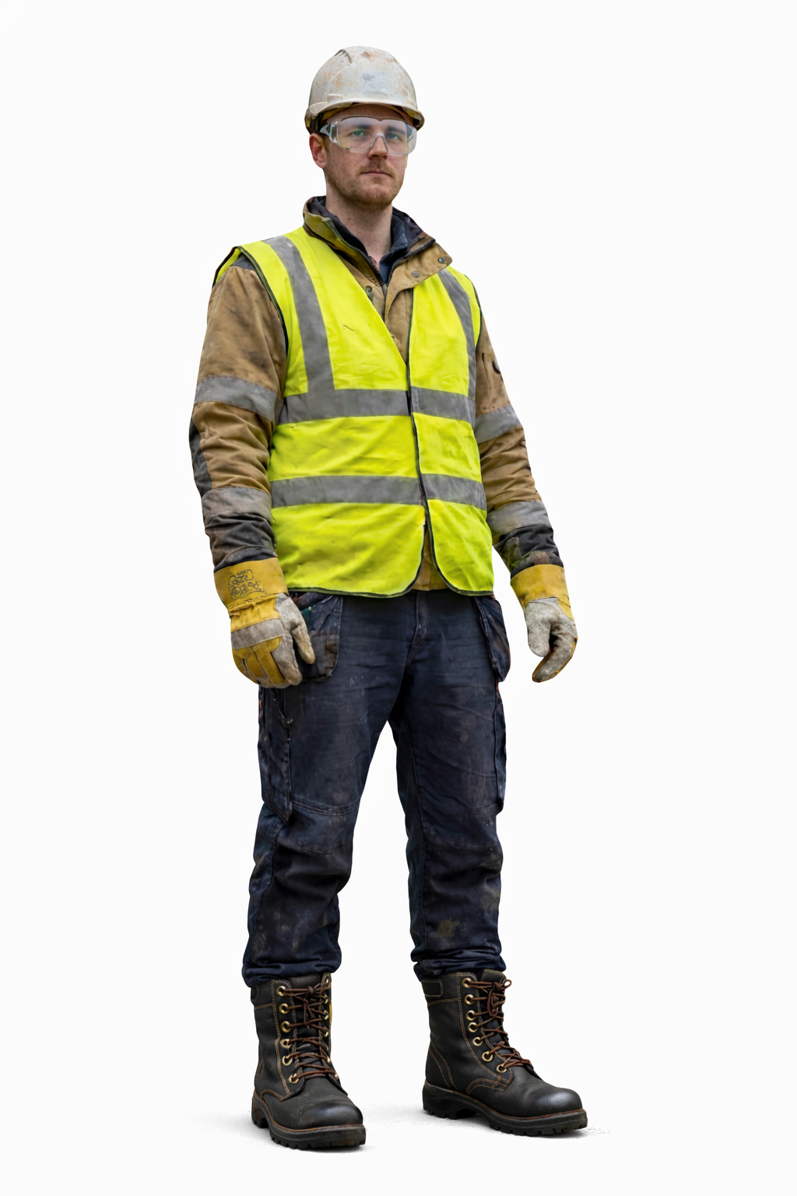
VWE: Morgan Sindall Construction – Day 2
Handout 3 – PPE
Label the 5 point PPE in this drawing. Use the boxes to explain what each part of the PPE does and why it is important.
Developing Experts Copyright 2026 All Rights Reserved

Slide 2
VWE: Morgan Sindall Construction – Day 2
Handout 3 – PPE
Answer the following questions about PPE.
True or False: A high-visibility vest is used to make workers more noticeable to others on a site. __________ Gloves are only needed when handling chemicals. ___________ Safety boots protect your feet from heavy objects. ___________
Jamie is working on a construction site. He needs to cut metal pipes, which could produce sparks and flying metal pieces. Which PPE items should Jamie wear in addition to the 5-point PPE? __________________________________________________________________
Why is it important to wear task-specific PPE even if you are already wearing the 5-point PPE? _____________________________________________________________________________________________________________________________________________________________________________________________________
A student work-experience group is visiting a construction site where drilling and cutting work is taking place. One student is wearing a hard hat, high-visibility vest, gloves, and safety boots, but no eye or ear protection. 4a. What risks is the student exposed to? ___________________________________________________________________________________________________________________________________ 4b. What PPE is missing and how could wearing it reduce the risk of injury? ____________________________________________________________________________________________________________________________________
Who do you think is responsible for ensuring that workers wear PPE on a construction site and why? ____________________________________________________________________________________________________________________________________
PPE isn’t only used in construction. Give three examples of PPE used outside construction. Think about sports, healthcare or home DIY projects. ____________________________________________________________________________________________________________________________________
Developing Experts Copyright 2026 All Rights Reserved

