Slide 1


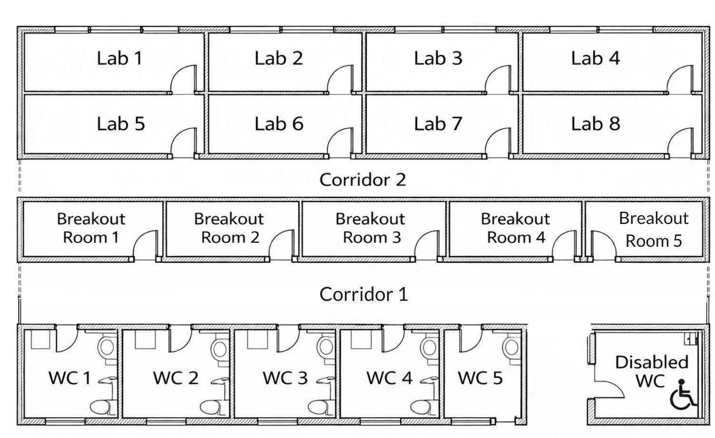
VWE: Morgan Sindall Construction – Day 2
Handout 2 – Sample boards
Read the client brief below. Use the sample board in the picture on the next page to choose fire alarm products for the lab floors of the project. For some requirements, there might be more than one product that you can choose from. Complete the form that follows with your choices to send to your supplier for a quote.
Client brief
Fire alarm provision (laboratory areas)
The laboratory areas shall be provided with a compliant fire detection and alarm system suitable for a science building.
Install automatic fire detection throughout laboratory floors, including smoke detectors in every space.
Provide one manual call point per space.
One fire alarm control panel should be available on each floor.
Provide audible and visual alarms within each laboratory, breakout space, bathroom and corridor to ensure alarms are noticeable in noisy environments.
Install emergency pull cords in all disabled bathrooms.
Ensure an emergency call point is available on every floor.
A ceiling loudspeaker should be in every space but an external horn loudspeaker is not required.
All fire alarm works to comply with current fire safety regulations and relevant standards. Final design to be confirmed during detailed coordination.
Rooms per lab floor
Labs: 8
Corridors: 2
Breakout rooms : 4
WCs: 5
Disabled WC: 1
Total number of lab floors: 10
Developing Experts Copyright 2026 All Rights Reserved

Slide 2
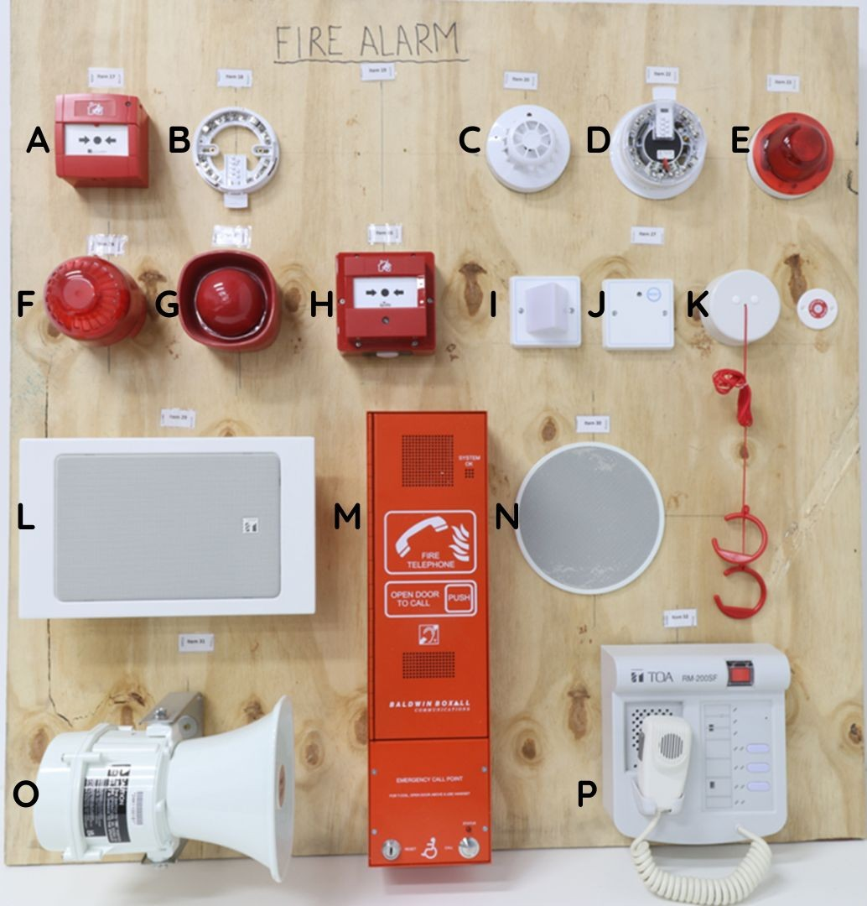
VWE: Morgan Sindall Construction – Day 2
Handout 2 – Sample boards
Key
A – Manual call point (break glass / resettable call point)
B – Detector mounting base
C – Smoke detector covered
D – Smoke detector (open / sensing head visible)
E – Visual alarm device (beacon)
F – Electronic sounder (alarm sounder)
G – Sounder beacon (combined sounder and visual alarm)
H – Manual call point (surface-mounted type)
I – Passive Infrared (PIR) detector (often used for security rather than fire)
J – Control / interface module (fire alarm ancillary module)
K – Emergency pull cord (disabled WC alarm)
L – Fire alarm control panel (or repeater panel)
M – Fire telephone / emergency call point (refuge or firefighter telephone)
N – Ceiling loudspeaker (voice alarm / PA system)
O – Horn loudspeaker (external or high-output alarm)
P – Voice alarm / PA control unit with handset
Developing Experts Copyright 2026 All Rights Reserved

Slide 3
VWE: Morgan Sindall Construction – Day 2
Handout 2 – Sample boards
Request a quote from a supplier
Ordering company name: ______________________
Project name: ________________________
Project location: _____________________
Total rooms per floor needing fire alarm products: ______________
Number of floors: _______________________
Order details:
Signed: _________________
Date: ___________________
Item letter | Item name | Quantity per floor | Total quantity
 |  | Total items required:
Developing Experts Copyright 2026 All Rights Reserved

Slide 4
VWE: Morgan Sindall Construction – Day 2
Handout 2 – Sample boards Answers
Request a quote from a supplier
Ordering company name: Morgan Sindall Construction
Project name: 17 Columbus Courtyard
Project location: Canary Wharf, London
Total rooms per floor needing fire alarm products: 20
Number of floors: 10
Order details:
Signed: _________________
Date: ___________________
Item letter | Item name | Quantity per floor | Total quantity
B | Detector mounting base | 20 | 200
C | Smoke detector covered | 20 | 200
A or H | Manual call points | 20 | 200
L | Fire alarm control panel | 1 | 10
E&F or G | Visual alarm device, electronic sounder or sounder beacon | 20 | 200
K | Emergency pull cord | 1 | 10
M | Fire telephone/emergency call point | 1 | 10
N | Ceiling loudspeaker | 20 | 200
 |  | Total items required: | 1030
Developing Experts Copyright 2026 All Rights Reserved

