Slide 1


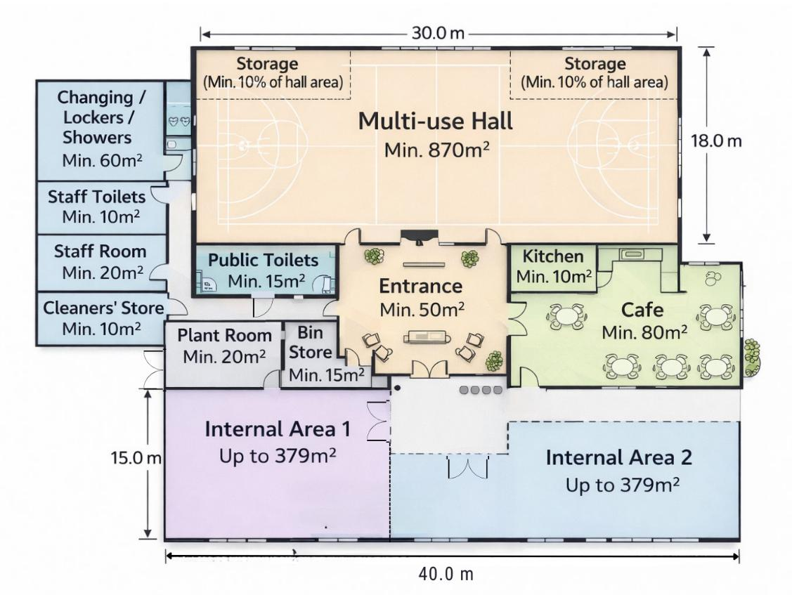
VWE: Morgan Sindall Construction – Project Day
Handout 1 – Design drawings
Take a look at the draft design drawing for BrightSpace Community Hub. Use the question prompts to check that the initial plans meet the client’s brief. You can also annotate the drawing to help you explain your answers to the questions.
Have all spaces in the client’s brief been planned in? Go back to the presentation slides to recap the client’s brief. ___________________________________________________________________ ___________________________________________________________________
Do the planned measurements correspond with the brief? ___________________________________________________________________ ___________________________________________________________________
Developing Experts Copyright 2026 All Rights Reserved

Slide 2
VWE: Morgan Sindall Construction – Project Day
Handout 1 – Design drawings
Have all the spaces got appropriate entrances and exits? Would you change any? ___________________________________________________________________ ___________________________________________________________________ ___________________________________________________________________
Take a look at the external windows. Are there enough? Would you add or take any away? Why? ___________________________________________________________________ ___________________________________________________________________ ___________________________________________________________________
What would you suggest the optional spaces are for? Internal area 1: ____________________________________ Internal area 2: ____________________________________
What do you think about the layout of the hub? Do you agree with where each room is located? Would you move any of the spaces around? ___________________________________________________________________ ___________________________________________________________________ ______________________________________________________________________________________________________________________________________ ___________________________________________________________________ ___________________________________________________________________
What do you think about the shape of each space? Are they appropriate or would you make changes? ___________________________________________________________________ ___________________________________________________________________ ___________________________________________________________________ ___________________________________________________________________ ___________________________________________________________________ ___________________________________________________________________
The outdoor space has not been put on this floorplan. Mark on the drawing where you think it should go. Why would you put it there? ___________________________________________________________________ ___________________________________________________________________ ___________________________________________________________________
Developing Experts Copyright 2026 All Rights Reserved

