Slide 1


VWE: Morgan Sindall Construction – Project Day
Handout 1 – Design drawings
Look at the draft design drawing for BrightSpace Community Hub on the next page. Use the question prompts to check that the initial plans meet the client’s brief. You can also annotate the drawing to help you explain your answers to the questions.
Client brief
Budget: £15 million Completion time: 60 weeks
BrightSpace Community Foundation have requested the following 4 spaces within the community hub building:
Entrance area - a large, open space to include an information desk as well as social space
Cafe - a cafe or restaurant to provide income to the community hub
Multi-use hall - a large hall to hold local events, performances, and sports classes; will need seating, changing rooms and toilet facilities
Outdoor space - an outdoor playground and picnic area
2 further spaces to improve the community. These could include a library, facilities for local schools/colleges, office spaces for people to come to for advice, rental spaces that could provide income for the hub or any other ideas you may have.
The GIFA (gross internal floor area) for the entire build is 1100m². The outdoor space can be up to 600m².
The minimum space the client would like for each area is as follows:
Entrance Min. 50m²
Cafe Min. 80m²
Kitchen Min. 10m²
Multi-use hall Min. 400m²
Storage Min. 10% of sports hall area
Public toilets Min. 15m²
Staff toilets Min. 10m²
Changing, locker and shower facilities Min. 30m²
Staff room Min. 20m²
Cleaners' store Min. 10m²
Plant room Min. 20m²
Bin store Min. 10m²
Allowance for 2 chosen internal areas Up to 350m²
Developing Experts Copyright 2026 All Rights Reserved

Slide 2
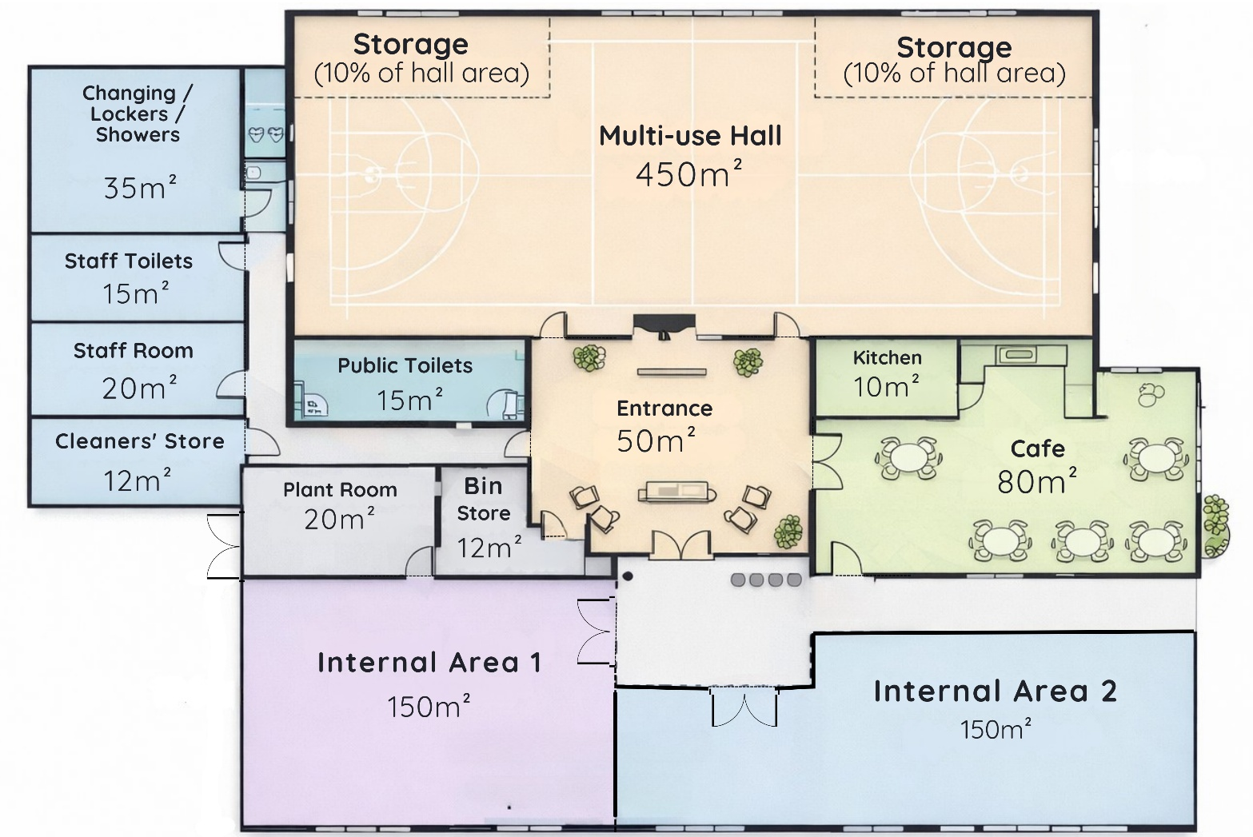
VWE: Morgan Sindall Construction – Project Day
Handout 1 – Design drawings
Have all spaces in the client’s brief been planned in? ___________________________________________________________________
Do the planned measurements meet the client’s minimum space requirements?
___________________________________________________________________
Do the measurements stay within the GIFA?
___________________________________________________________________
Is there any space left over? If so, how much?
___________________________________________________________________
Developing Experts Copyright 2026 All Rights Reserved

Slide 3
VWE: Morgan Sindall Construction – Project Day
Handout 1 – Design drawings
Have all the spaces got appropriate entrances and exits? Would you change any?
___________________________________________________________________
___________________________________________________________________
___________________________________________________________________
Take a look at the external windows. Are there enough? Would you add or take any away? Why?
___________________________________________________________________
___________________________________________________________________
___________________________________________________________________
What would you suggest the optional spaces are for?
Internal area 1: ____________________________________
Internal area 2: ____________________________________
What do you think about the layout of the hub? Do you agree with where each room is located? Would you move any of the spaces around?
___________________________________________________________________
___________________________________________________________________
______________________________________________________________________________________________________________________________________
___________________________________________________________________
___________________________________________________________________
What do you think about the shape of each space? Are they appropriate, or would you make changes?
___________________________________________________________________
___________________________________________________________________
___________________________________________________________________
___________________________________________________________________
___________________________________________________________________
___________________________________________________________________
The outdoor space has not been put on this floorplan. Mark on the drawing where you think it should go. Why would you put it there?
___________________________________________________________________
___________________________________________________________________
___________________________________________________________________
Developing Experts Copyright 2026 All Rights Reserved

Slide 4
VWE: Morgan Sindall Construction – Project Day
Handout 1 – Design drawings Answers
Have all spaces in the client’s brief been planned in?
Yes, all listed spaces are on the drawing.
Do the planned measurements meet the client’s minimum space requirements?
Yes, the drawing meets all the minimum space requirements.
Do the measurements stay within the GIFA?
Yes, when totalled, the measurements are under the GIFA of 1100m².
Is there any space left over? If so, how much?
The total space on the drawing equals 1019m², meaning there is 81m² unused.
Have all the spaces got appropriate entrances and exits? Would you change any?
Answers will vary. Students should consider whether users can get in and out of each room and think about whether the appropriate spaces have internal or external doors.
Take a look at the external windows. Are there enough? Would you add or take any away? Why?
Answers will vary. Students may comment on the staff room, toilets, lockers, and showers not having any windows and whether these are necessary.
What would you suggest the optional spaces are for?
Internal area 1: Answers will vary
Internal area 2: Answers will vary
What do you think about the layout of the hub? Do you agree with where each room is located? Would you move any of the spaces around?
Answers will vary. Students should consider who needs to use each space and whether the access is correct.
What do you think about the shape of each space? Are they appropriate, or would you make changes?
Answers will vary. Students should consider the main purpose of each space and whether the layout is appropriate. They should think about whether there is enough room for each space’s intended use.
The outdoor space has not been put on this floorplan. Mark on the drawing where you think it should go. Why would you put it there?
Answers will vary. Students should consider who would need most access to the open space. For example, it could be used for additional sport space, or it could be attached to the café for parents to keep an eye on their children whilst they play.
Developing Experts Copyright 2026 All Rights Reserved

