Slide 1


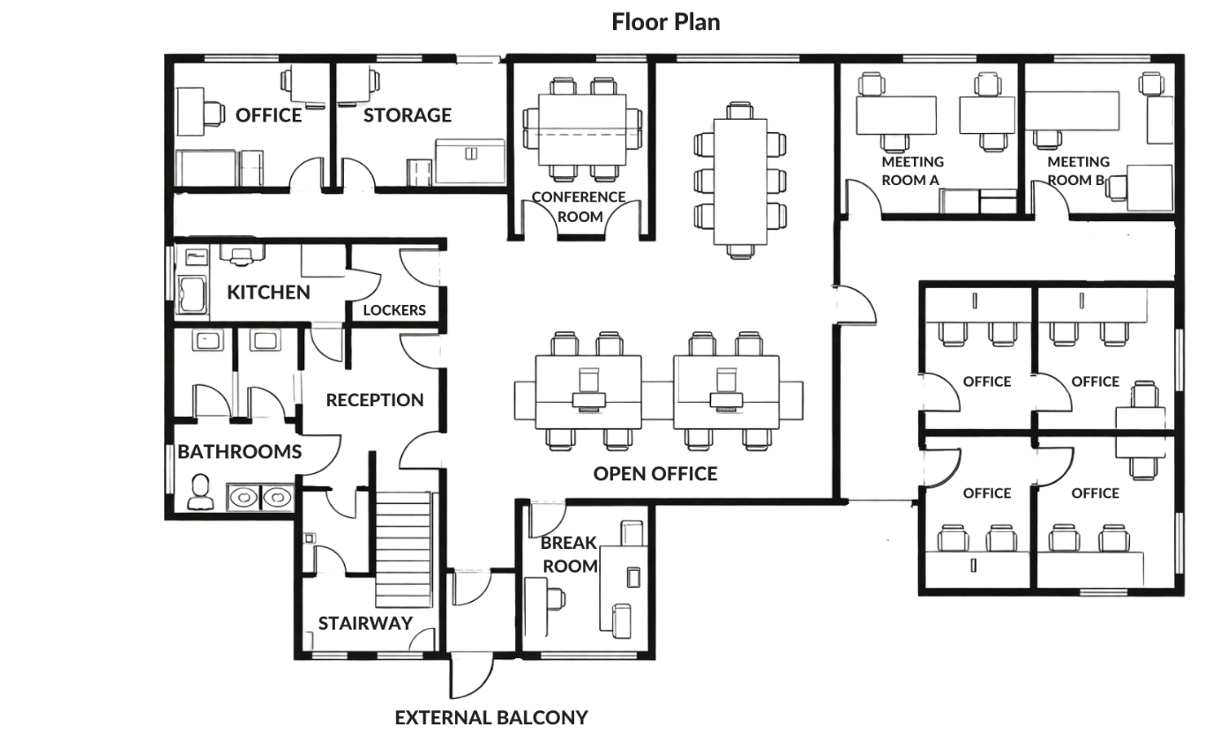

VWE: Morgan Sindall Construction – Day 1
Handout 4 – Design manager task
Here is the architectural drawing of an office building. You will read and create a scope mark-up for this drawing. Use the next page to guide you.
Developing Experts Copyright 2026 All Rights Reserved

Slide 2


VWE: Morgan Sindall Construction – Day 1
Handout 4 – Design manager task
Answer the following questions.
Reading a drawing
How many meeting rooms will be built on this floor? ____________
Doors are drawn in this shape on an architectural drawing:
Why do you think this might be? ______________________________________________________________________________________________________________________ ______________________________________________________________________________________________________________________
How many doors lead into the kitchen? ____________
How many external doors are there in this drawing? ____________
Windows are shown like this on the drawing:
Why does the locker room not have any windows?
______________________________________________________________________________________________________________________
Which other rooms do not have any windows?
______________________________________________________________________________________________________________________
Why do you think the break room is located where it is?
______________________________________________________________________________________________________________________
Developing Experts Copyright 2026 All Rights Reserved

Slide 3
VWE: Morgan Sindall Construction – Day 1
Handout 4 – Design manager task
Annotate the drawing on page 1 using the instructions below.
Scope mark-up
The subcontractor’s scope is the work that they are responsible for on a project. Your job as a design manager is to send a marked-up drawing to your subcontractor, showing exactly what work they are responsible for.
Subcontractor A is responsible for making all internal doors on this floor that are not part of the bathroom or kitchen.
A different contractor is completing the storage and locker room doors as they will need additional security elements, so they are excluded from this scope, too.
You need to mark-up the drawing on page 1 to send to Subcontractor A. You can highlight, circle or box the doors that they are responsible for. You need to clearly mark all doors that are not in their scope, too. You could do this by using a different colour, or label as, ‘By others’. Be as detailed as you can: you can add notes to the drawing and make clear exactly what you expect.
You can be creative in how you complete this task. You can add your own details to the drawing. For example, you might highlight the type of flooring each door must be compatible with for the subcontractor.
Use this as a chance to show your future employer that you can be accurate, creative and think like a design manager.
Developing Experts Copyright 2026 All Rights Reserved

Slide 4
VWE: Morgan Sindall Construction – Day 1
Handout 4 – Design manager answers
Answer sheet
Reading a drawing
How many meeting rooms will be built on this floor? 2
Doors are drawn in this shape on an architectural drawing:
Why do you think this might be?
The diagram shows the direction that a door will open. This is needed on a floor plan because that amount of floorspace will need to be clear so the door can be opened and used.
How many doors lead into the kitchen? 2
How many external doors are there in this drawing? 1
Windows are shown like this on the drawing:
Why does the locker room not have any windows?
The locker room does not have windows because it has no external walls. It is in the middle of the building.
Which other rooms do not have any windows?
Two of the offices, the reception area, the bathroom cubicles.
Why do you think the break room is located where it is?
The break room will be where staff go to eat lunch, chat and go on their phones. It might be loud and so is best placed on its own, away from working areas. The break room does not share a wall with any meeting rooms or conference rooms where people may need quiet. It is also next to the balcony where staff might want to go for their break or for fresh air.
Developing Experts Copyright 2026 All Rights Reserved

Slide 5
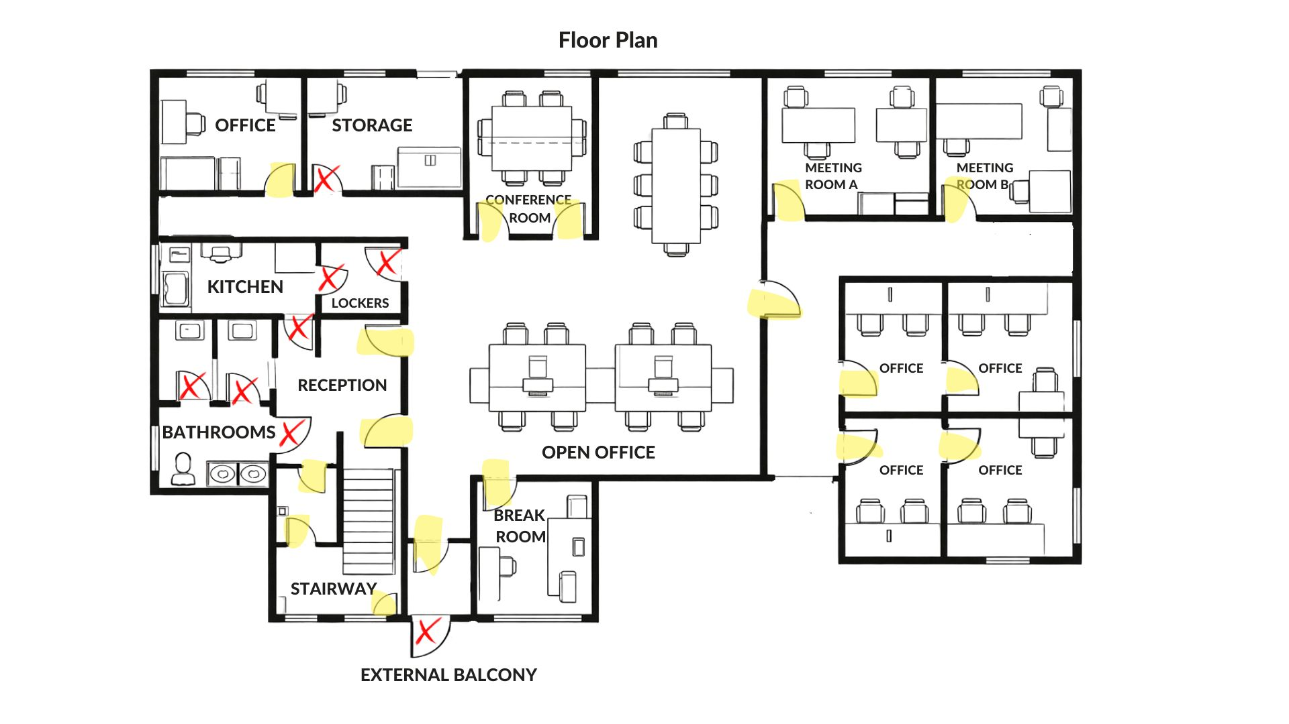
VWE: Morgan Sindall Construction – Day 1
Handout 4 – Design manager answers
Answer sheet
The doors highlighted in yellow are the doors that should have been included in Subcontractor A’s scope. Those with the red crosses should be clearly labelled for a different subcontractor. This could have been demonstrated in a variety of ways.
Developing Experts Copyright 2026 All Rights Reserved

