Slide 1


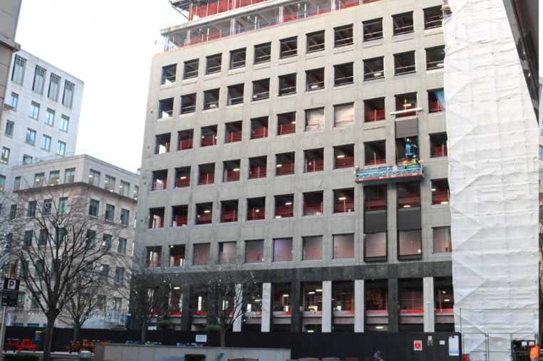
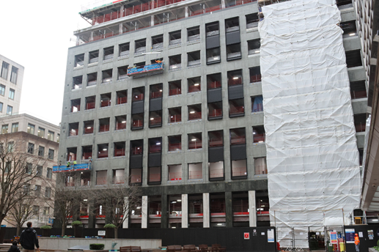
VWE: Morgan Sindall Construction – Day 4
Handout 3 – Invoice approval
Here are images of the front of 17 Columbus Courtyard taken on two different dates. You are hoping to process stage one of the window frame subcontractor’s payment. Focus your attention on the window frames: an example of one has been circled in the image below.
10th December 2025, 12:30
12th December 2025, 16:00
Developing Experts Copyright 2026 All Rights Reserved

Slide 2
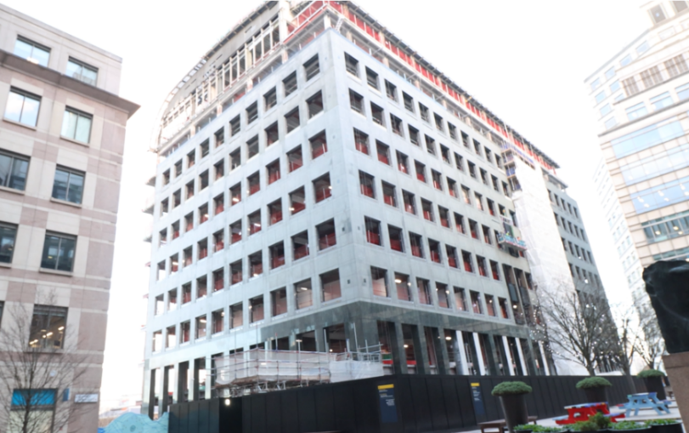
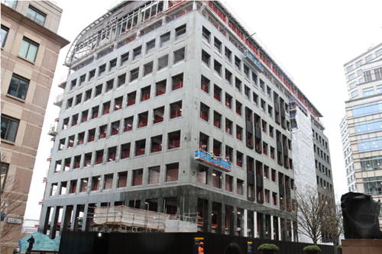
VWE: Morgan Sindall Construction – Day 4
Handout 3 – Invoice approval
10th December 2025, 12:30
12th December 2025,16:00
Developing Experts Copyright 2026 All Rights Reserved

Slide 3
VWE: Morgan Sindall Construction – Day 4
Handout 3 – Invoice approval
Read through the planned schedule for this subcontractor and work out whether the work has been done on time.
Window frame installation schedule
Day 1 – 10th December
08:00 – 09:00 → Unload materials and tools
09:00 – 12:30 → Fit 3 window frames
12:30 – 13:30 → Lunch
13:30 – 16:30 → Fit 2 more window frames
Day 2 – 11th December
08:00 – 12:00 → Fit 3 window frames
12:00 – 13:00 → Lunch
13:00 – 16:30 → Fit 2 more window frames
Day 3 – 12th December
08:00 – 12:00 → Fit 3 window frames
12:00 – 13:00 → Lunch
13:00 – 16:00 → Quality check and briefing for next week
By midday Day 1, were the subcontractors on schedule?
_______________________________
How many window frames were planned to be fitted by the end of Day 2?
_______________________________
Before the quality check on Day 3, how many window frames should have been fitted?
_______________________________
Did the subcontractors end Day 3 on or behind schedule?
_______________________________
What work, if any, was left incomplete by the end of Day 3?
_______________________________
If the subcontractor continued at the same rate, predict how long you think it would take to fit 15 more window frames.
_______________________________
Developing Experts Copyright 2026 All Rights Reserved

Slide 4
VWE: Morgan Sindall Construction – Day 4
Handout 3 – Invoice approval
Use your answers from page 3 to complete the approval section of the invoice below. The prices have all been input for you; you do not need to calculate them. This form will be sent to the subcontractor and finance team.
Invoice approval form
Project name: 17 Columbus Courtyard
Invoice number: LG283-943-X
Invoice date: 12th December 2025
Subcontractor: Skyline Window Fitting
Approval
Verified by (name/position): ___________________________
Date verified: ___________________
Approval status:
☐ Approved for payment
☐ Requires correction/clarification
Notes to subcontractor:
Signature: _________________________
Description of work | Quantity | Unit cost (£) | Total cost (£)
Supply and fit window frames | 13 | 150 | 1950
Labour (3 days) | 24 hours | 25 | 600
Materials |  |  | 100
Subtotal |  |  | 2,650
VAT (20%) |  |  | 530
Total amount due |  |  | 3,180
Developing Experts Copyright 2026 All Rights Reserved

Slide 5
VWE: Morgan Sindall Construction – Day 4
Handout 3 – Invoice approval Answers
Read through the planned schedule for this subcontractor and work out whether the work has been done on time.
Window frame installation schedule
Day 1 – 10th December
08:00 – 09:00 → Unload materials and tools
09:00 – 12:30 → Fit 3 window frames
12:30 – 13:30 → Lunch
13:30 – 16:30 → Fit 2 more window frames
Day 2 – 11th December
08:00 – 12:00 → Fit 3 window frames
12:00 – 13:00 → Lunch
13:00 – 16:30 → Fit 2 more window frames
Day 3 – 12th December
08:00 – 12:00 → Fit 3 window frames
12:00 – 13:00 → Lunch
13:00 – 16:00 → Quality check and briefing for next week
By midday Day 1, were the subcontractors on schedule?
Yes
How many window frames were planned to be fitted by the end of Day 2?
10
Before the quality check on Day 3, how many window frames should have been fitted?
13
Did the subcontractors end Day 3 on or behind schedule?
Behind schedule
What work, if any, was left incomplete by the end of Day 3?
3 window frames to be fitted
If the subcontractor continued at the same rate, predict how long you think it would take to fit 15 more window frames.
Approximately 4 and a half days
Developing Experts Copyright 2026 All Rights Reserved

Slide 6
VWE: Morgan Sindall Construction – Day 4
Handout 3 – Invoice approval Answers
Use your answers from page 3 to complete the approval section of the invoice below. The prices have all been input for you; you do not need to calculate them. This form will be sent to the subcontractor and finance team.
Invoice approval form
Project name: 17 Columbus Courtyard
Invoice number: LG283-943-X
Invoice date: 12th December 2025
Subcontractor: Skyline Window Fitting
Approval
Verified by (name/position): Student’s name (or Liam’s name)
Date verified: Today’s date
Approval status:
☐ Approved for payment
☐ Requires correction/clarification
Notes to subcontractor:
Notes should be included here about being behind schedule and 3 windows being outstanding by the end of Day 3.
Signature: Student’s signature (or Liam’s name)
Description of work | Quantity | Unit cost (£) | Total cost (£)
Supply and fit window frames | 13 | 150 | 1950
Labour (3 days) | 24 hours | 25 | 600
Materials |  |  | 100
Subtotal |  |  | 2,650
VAT (20%) |  |  | 530
Total amount due |  |  | 3,180
Developing Experts Copyright 2026 All Rights Reserved

