Slide 1


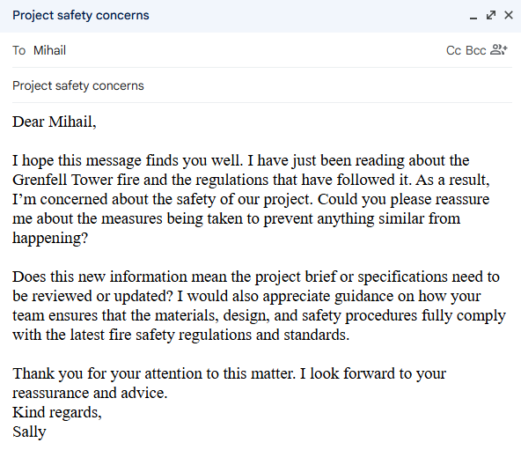
VWE: Morgan Sindall Construction – Day 4
Handout 2 – Client query
To reply to the client’s email confidently, it is important to prepare and make sure you know the exact answers. Firstly, you need to research the answers to the client’s questions.
1. Re-read the email from the client:
2. Use the space below to research what happened at Grenfell Tower: how did the fire start? What allowed it to spread so rapidly?
________________________________________________________________________________________________________________________________________________________________________________________________________________________________________________________________________________________________________________________________________________________________________________________________________________________________________________________________________________________________________________________________________________________________________________________________________________________________________________________________________________________________________________________________________________________________________________________________________________________________________________________________________
Developing Experts Copyright 2026 All Rights Reserved

Slide 2
VWE: Morgan Sindall Construction – Day 4
Handout 2 – Client query
3. Research the changes that came into place for the construction industry following the Grenfell tragedy: what fire safety regulations and measures were introduced in the UK?
________________________________________________________________________________________________________________________________________________________________________________________________________________________________________________________________________________________________________________________________________________________________________________________________________________________________________________________________________________________________________________________________________________________________________________________________________________________________________________________________________________________________________________________________________________________________________________________________________________________________________________________________________________________________________________________________________________________________________________________________________________________________________________________________________________________________________________________________________________________________
4. Think about how this affects the 17 Columbus Courtyard project: make a list of all the things that would need to be checked to make sure regulations are followed, and the building is fire safe. Two examples have been given below:
Are all fire doors correctly rated and fitted with approved hardware?
Are self-closing devices installed and functioning properly?
________________________________________________________________________________________________________________________________________________________________________________________________________________________________________________________________________________________________________________________________________________________________________________________________________________________________________________________________________________________________________________________________________________________________________________________________________________________________________________________________________________________________________________________________________________________________________________________________________________________________________________________________________
Developing Experts Copyright 2026 All Rights Reserved

Slide 3

VWE: Morgan Sindall Construction – Day 4
Handout 2 – Client query
Use the proforma to draft a concise, professional email addressing all client questions. Focus on reassurance rather than detailing regulations, demonstrating your expertise so the client feels that they are in capable hands.
To: __________________________________________________________________
Subject line: __________________________________________________________
Main body:
__________________________________________________________________________________________________________________________________________________________________________________________________________________________________________________________________________________________________________________________________________________________________________________________________________________________________________________________________________________________________________________________________________________________________________________________________________________________________________________________________________________________________________________________________________________________________________________________________________________________________________________________________________________________________________________________________________________________________________________________________________________________________________________________________________________________________________________________________________________________________________________________________________________________________________________________________________________________________________________________________________________________________________________________________________________________________________________________________________________________________________________________________________________________________________________________________________________________________________________________________________
SEND
Developing Experts Copyright 2026 All Rights Reserved

