Slide 1


VWE: Morgan Sindall Construction – Day 3
Handout 3 – Inspecting work on site
Study the glossary below to learn the construction jargon needed for this task. Then use the image handout sheets that follow to complete the quality inspection form as a site manager.
Glossary
BG screw – A type of screw manufactured by British Gypsum.
British Gypsum (BG) – A company that manufactures plaster, plasterboard, and other building materials widely used in the UK construction industry.
Builders’ work holes – Openings left in walls, floors, or ceilings during construction to allow pipes or cables to pass through.
Fire line board – A fire-resistant board, often made from gypsum, that helps prevent the spread of fire in walls or ceilings.
Fixing centre - The distance between each fixing point, such as screws, when attaching a material to a surface or frame.
Fixing type – The method or kind of fastener used to attach a material, such as screws, nails, or adhesives.
Gypsum – A soft, white or grey mineral made of calcium sulphate, commonly used to make plaster, plasterboard, and cement.
Insulation – Material used in walls, floors, or ceilings to reduce heat transfer, sound, or vibration, making buildings more energy-efficient.
Mastic – A thick adhesive or sealant used in construction to stick materials together or to seal joints and gaps.
Screw – A type of fastener used to join materials together, commonly used to fix boards to studs or metal frameworks.
Stud centre – The distance between the centres of two vertical studs in a wall or partition, which determines how strong the wall is and how panels are fixed.
Developing Experts Copyright 2026 All Rights Reserved

Slide 2
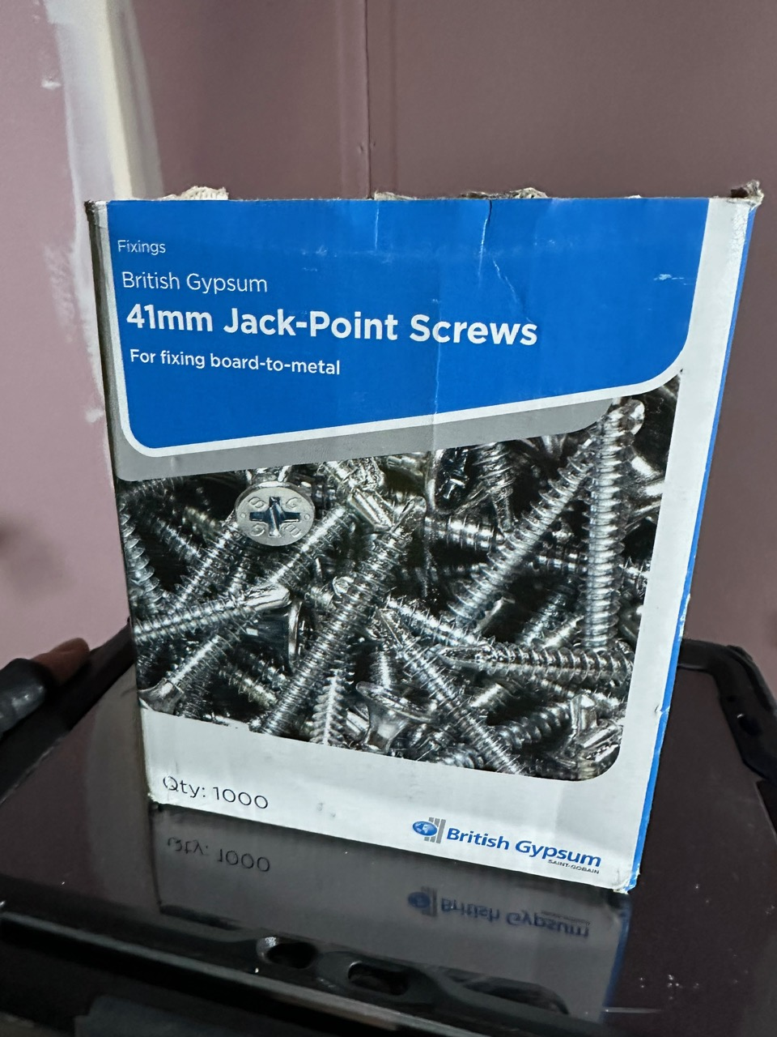
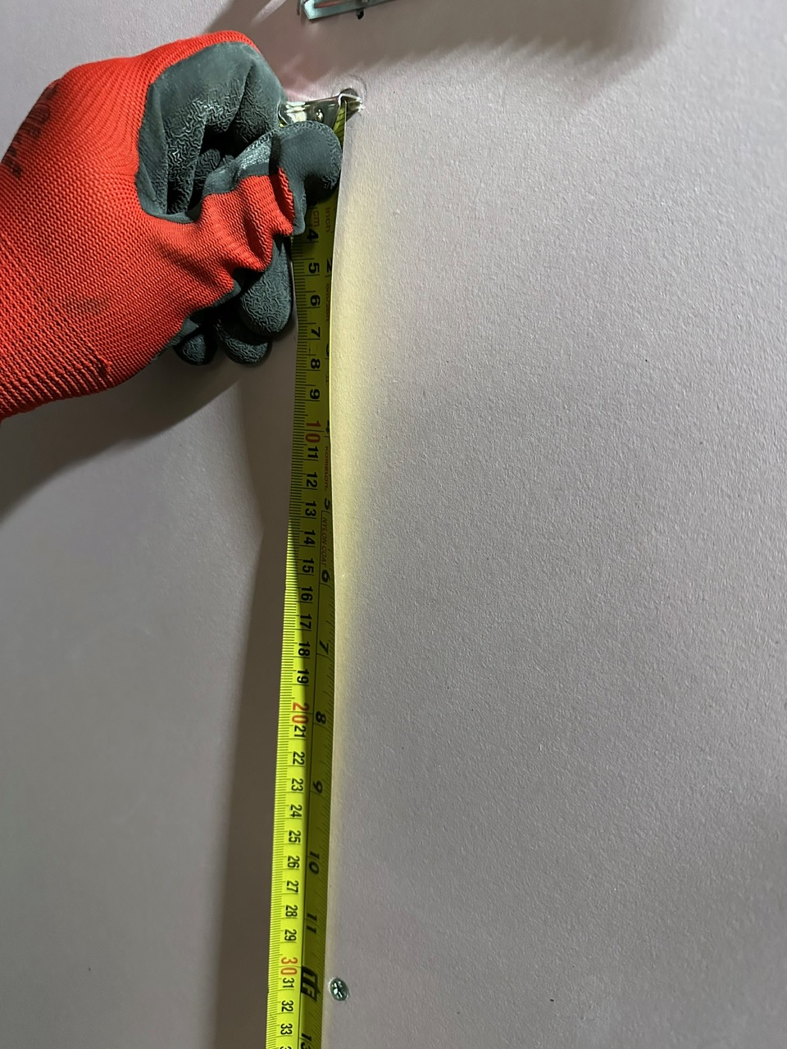
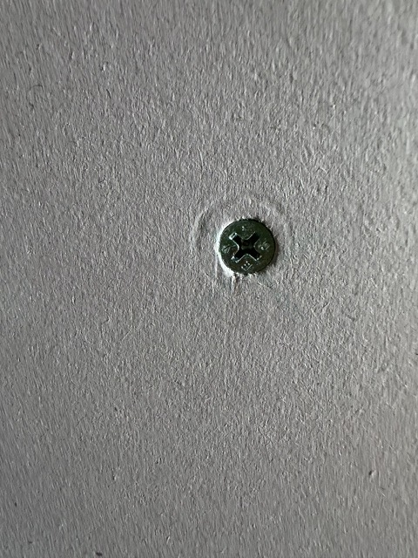
VWE: Morgan Sindall Construction – Day 3
Handout 3 – Inspecting work on site
Developing Experts Copyright 2026 All Rights Reserved

Slide 3
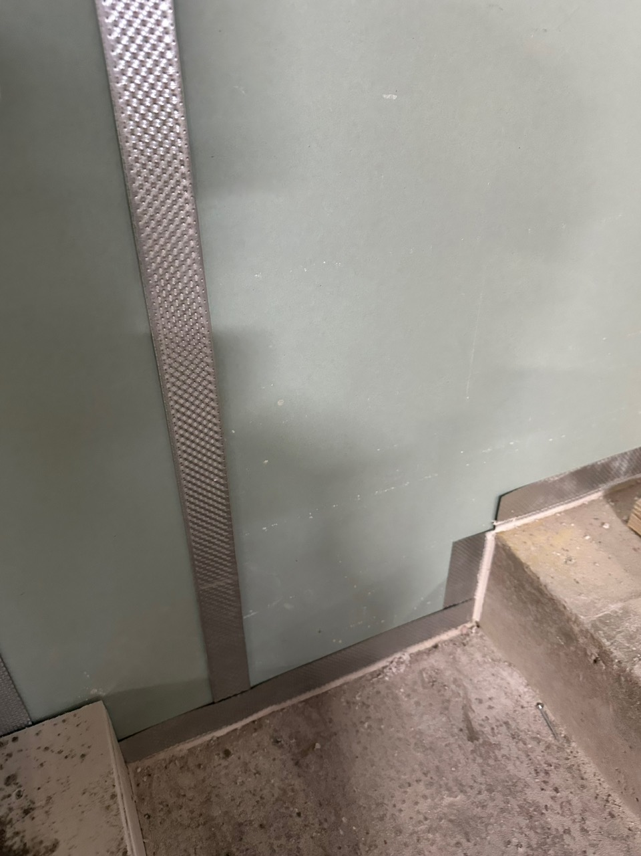
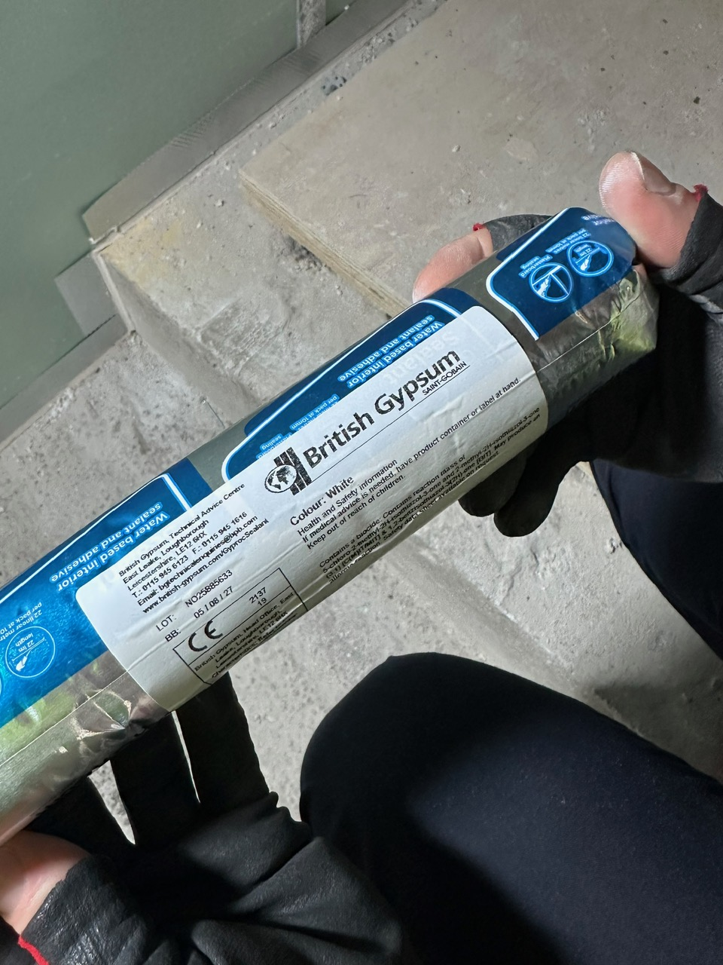
VWE: Morgan Sindall Construction – Day 3
Handout 3 – Inspecting work on site
Developing Experts Copyright 2026 All Rights Reserved

Slide 4
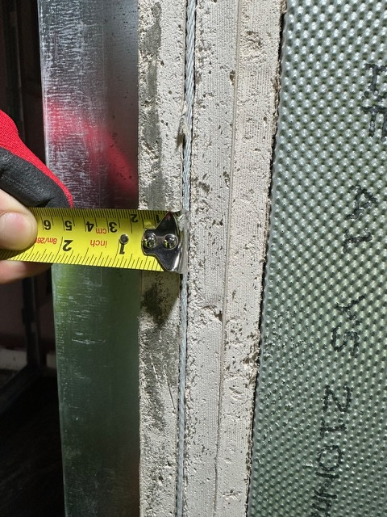
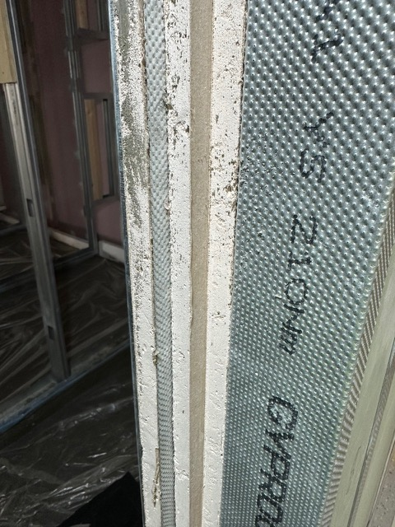
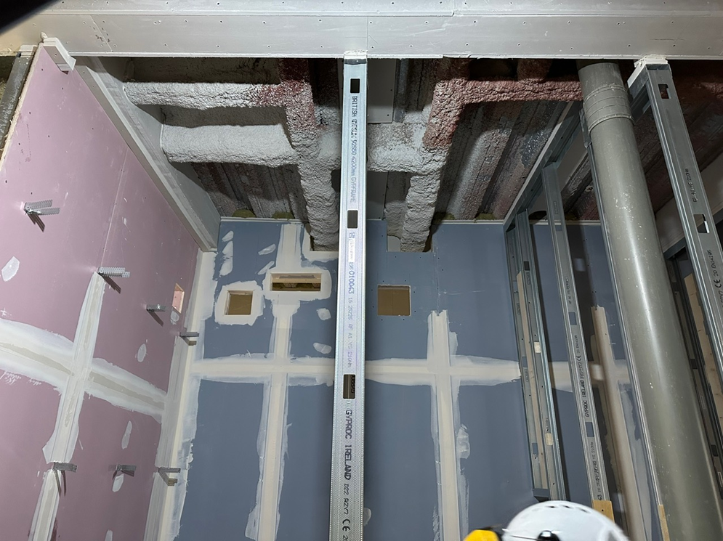
VWE: Morgan Sindall Construction – Day 3
Handout 3 – Inspecting work on site
Developing Experts Copyright 2026 All Rights Reserved

Slide 5
VWE: Morgan Sindall Construction – Day 3
Handout 3 – Inspecting work on site
Use the images to complete the quality inspection form.
Quality inspection form
Project name: ________________________________
Inspector name: ________________________________
Area/room inspected: ________________________________
Stud and framing
Are studs set out at the correct centres of 2cm (with 10mm flexibility)?
☐ Yes ☐ No ☐ N/A
Comments: ________________________________________________
Fixings and materials
Is the correct fixing type (BG 41mm Jack-Point screws) used?
☐ Yes ☐ No ☐ N/A
Comments: ________________________________________________
Are the correct screws properly and securely installed?
☐ Yes ☐ No ☐ N/A
Comments: ________________________________________________
Do the installed fixing centres comply with the specified spacing requirements of 35cm?
☐ Yes ☐ No ☐ N/A
Comments: ________________________________________________
Fire line board
Are there three fire line boards installed within one wall?
☐ Yes ☐ No ☐ N/A
Comments: ________________________________________________
Developing Experts Copyright 2026 All Rights Reserved

Slide 6
VWE: Morgan Sindall Construction – Day 3
Handout 3 – Inspecting work on site
Services and openings
Are there two square and two rectangular builders’ work holes on the back wall?
☐ Yes ☐ No ☐ N/A
Comments: ________________________________________________
Are the builders’ work holes neat?
☐ Yes ☐ No ☐ N/A
Comments: ________________________________________________
Finishes and protection
Is mastic applied neatly and continuously to seal gaps and joints between the concrete floor and wall panels?
☐ Yes ☐ No ☐ N/A
Comments: ________________________________________________
Manufacturer compliance
Is the installation compliant with British Gypsum (BG) specifications and guidance in that the screws and sealant are BG?
☐ Yes ☐ No ☐ N/A
Comments: ________________________________________________
Overall Assessment
Overall quality of work:
☐ Pass ☐ Fail ☐ Requires Remedial Work
Summary Comments:
Inspector Signature: ________________________________
Date: ________________________________
Developing Experts Copyright 2026 All Rights Reserved

Slide 7
VWE: Morgan Sindall Construction – Day 3
Handout 3 – Inspecting work on site Answers
Quality inspection form
Project name: 17 Columbus Courtyard
Inspector name: Name of pupil or Shayne Marples
Area/room inspected: Level 9
Stud and framing
Are studs set out at the correct centres of 2cm (with 10mm flexibility)?
☐ Yes ☐ No ☐ N/A
Comments: ________________________________________________
Fixings and materials
Is the correct fixing type (BG 41mm Jack-Point screws) used?
☐ Yes ☐ No ☐ N/A
Comments: ________________________________________________
Are the correct screws properly and securely installed?
☐ Yes ☐ No ☐ N/A
Comments: ________________________________________________
Do the installed fixing centres comply with the specified spacing requirements of 35cm?
☐ Yes ☐ No ☐ N/A
Comments: The fixing centres measure at 31cm meaning they are too close together and need changing.
Fire line board
Are there three fire line boards installed within one wall?
☐ Yes ☐ No ☐ N/A
Comments: ________________________________________________
Developing Experts Copyright 2026 All Rights Reserved

Slide 8
VWE: Morgan Sindall Construction – Day 3
Handout 3 – Inspecting work on site Answers
Services and openings
Are there two square and two rectangular builders’ work holes on the back wall?
☐ Yes ☐ No ☐ N/A
Comments: There are three square and only one rectangle.
Are the builders’ work holes neat?
☐ Yes ☐ No ☐ N/A
Comments: ________________________________________________
Finishes and protection
Is mastic applied neatly and continuously to seal gaps and joints between the concrete floor and wall panels?
☐ Yes ☐ No ☐ N/A
Comments: ________________________________________________
Manufacturer compliance
Is the installation compliant with British Gypsum specifications and guidance in that the screws and sealant are BG?
☐ Yes ☐ No ☐ N/A
Comments: ________________________________________________
Overall Assessment
Overall quality of work:
☐ Pass ☐ Fail ☐ Requires Remedial Work
Summary Comments:
Inspector Signature: ________________________________
Date: ________________________________
Developing Experts Copyright 2026 All Rights Reserved

