Slide 1


VWE: Morgan Sindall Construction – Project Day
Handout 6 – Press release
You need to prepare a press release for social media to promote the community hub project. Use the checklist below to make sure you capture everything. You can complete this activity on paper or digitally. Your release needs to be bright, catchy and creative. Go back through the programme on the Developing Experts platform if you need any reminders of the project details.
Press release writing checklist
Wording:
Catchy title
Key dates
Key locations
Information paragraph - Who? What? When? Where? Why?
The impact of this project on the local community
The sustainability of the timber
The reduced carbon footprint
A quote - from the client, or someone in the local community
Professional, simple language (no slang)
A link or contact for further information
Include hashtags to increase visibility on platforms
Morgan Sindall Construction values/branding
BrightSpace Community Foundation branding
Correct spelling/grammar
  Design:
Visuals of the project or the location
An infographic (for example, a map, a timeline or a graph)
  Colourful wording and/or borders
  Graphics to complement the information
Developing Experts Copyright 2026 All Rights Reserved

Slide 2
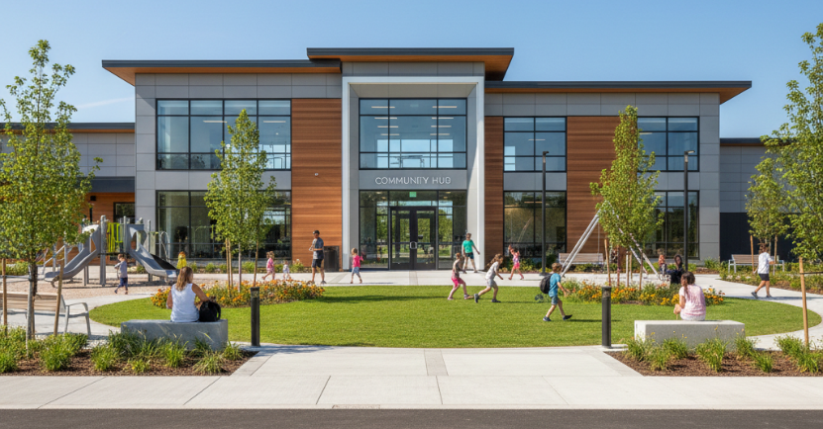
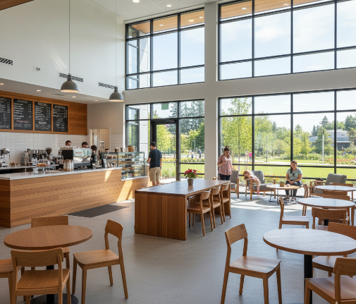



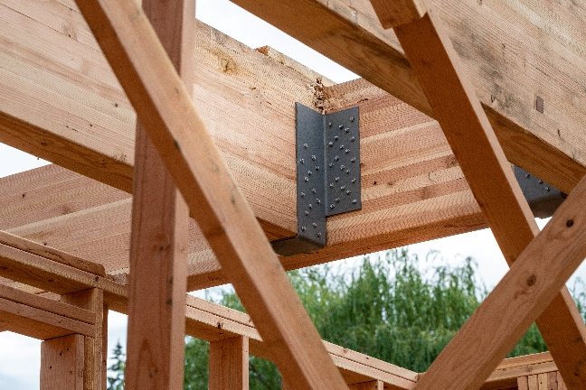
VWE: Morgan Sindall Construction – Project Day
Handout 6 – Press release
Here are some images that you can use in your press release.
Architectural renderings of the project
Morgan Sindall
Construction logo
Forest Stewardship Council logo
BrightSpace logo
Glulam timber beams
Developing Experts Copyright 2026 All Rights Reserved

