Slide 1


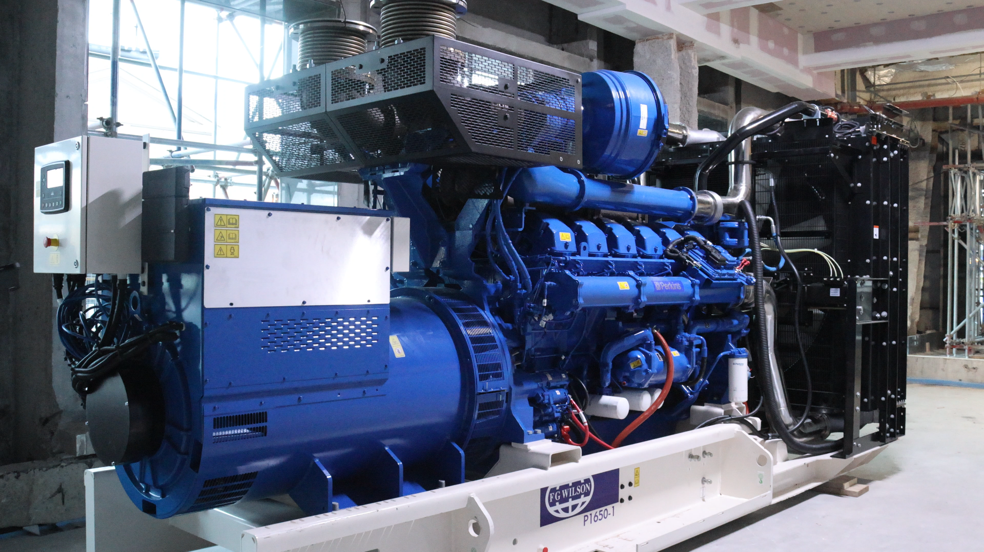
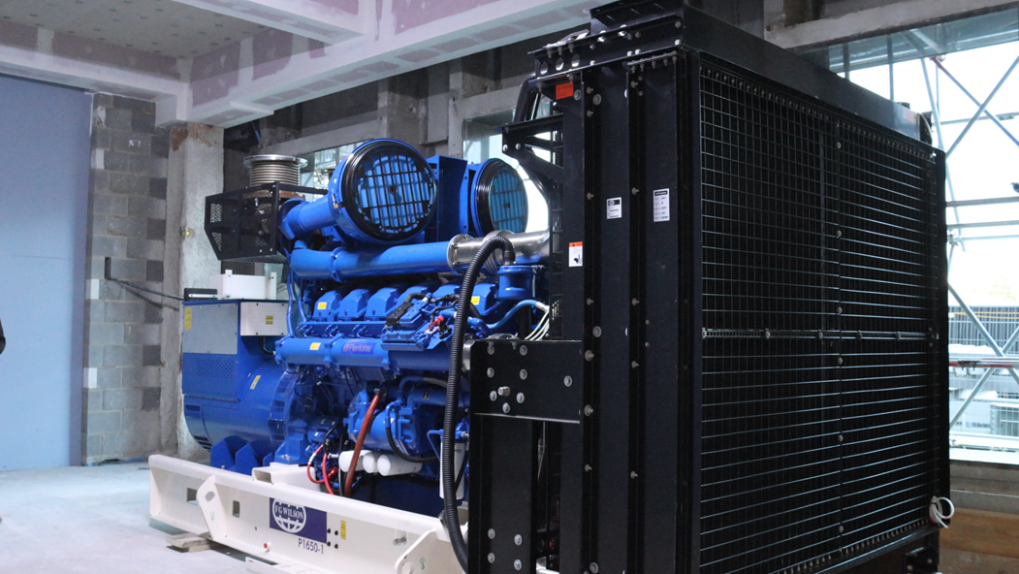
VWE: Morgan Sindall Construction – Day 2
Handout 1 – Generator task
The generator below has been delivered. Look carefully at the pictures on the next four pages and complete the inspection form that follows.
Developing Experts Copyright 2026 All Rights Reserved

Slide 2
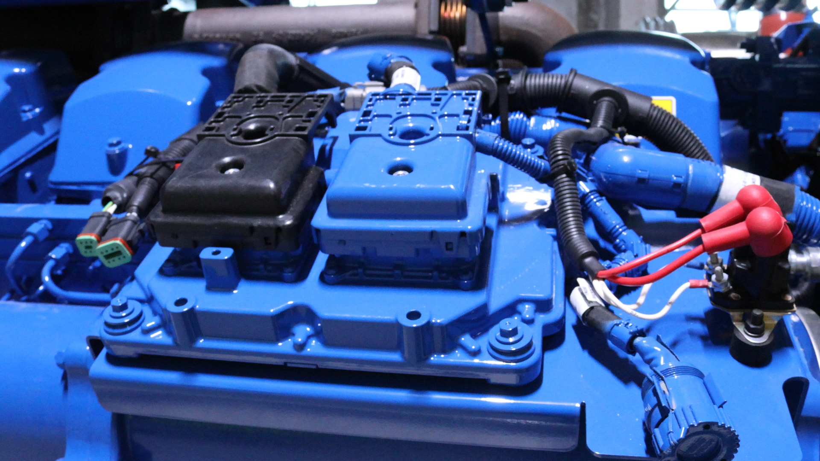
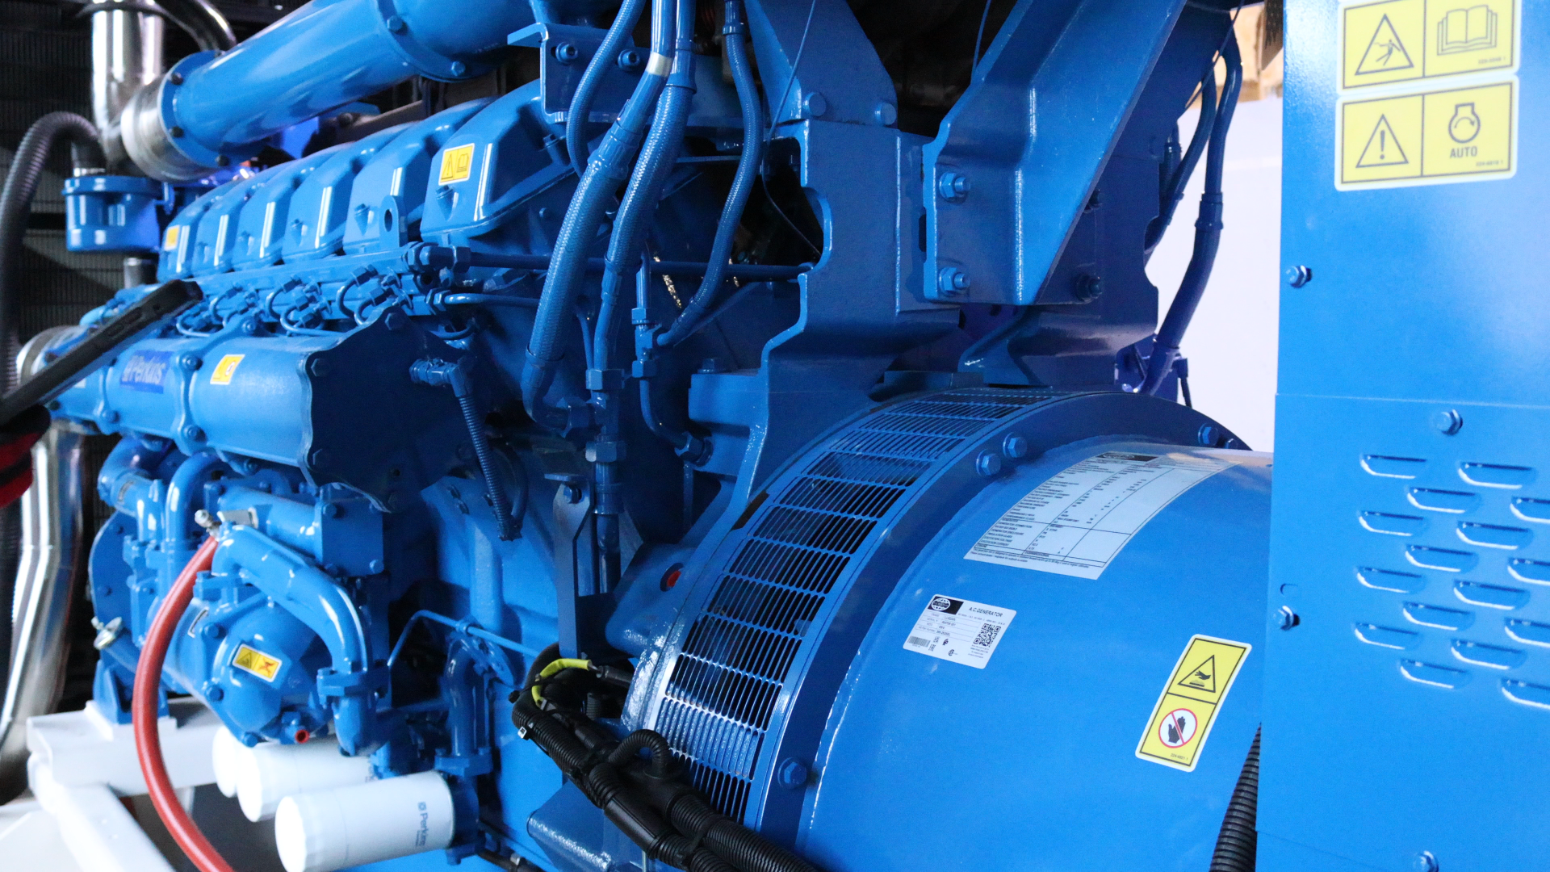
VWE: Morgan Sindall Construction – Day 2
Handout 1 – Generator task
Developing Experts Copyright 2026 All Rights Reserved

Slide 3
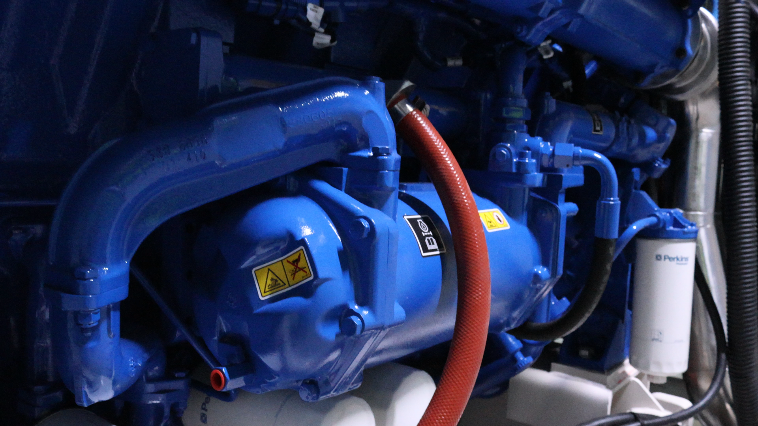
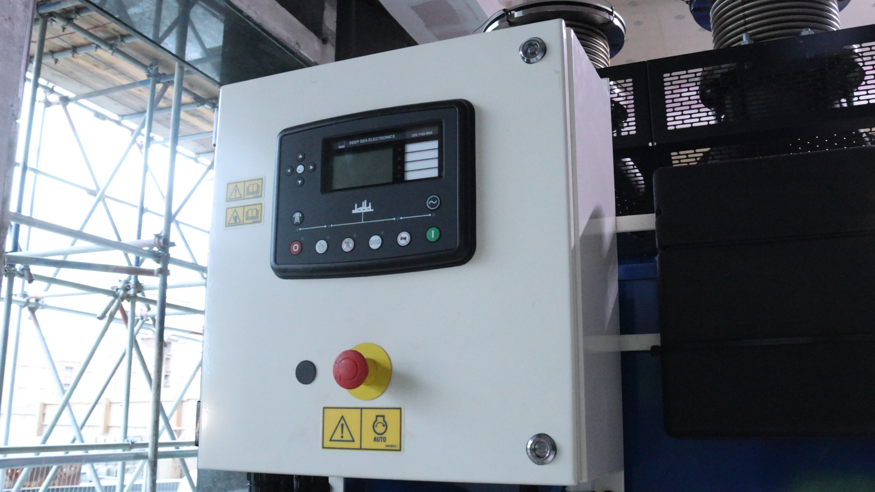
VWE: Morgan Sindall Construction – Day 2
Handout 1 – Generator task
Developing Experts Copyright 2026 All Rights Reserved

Slide 4
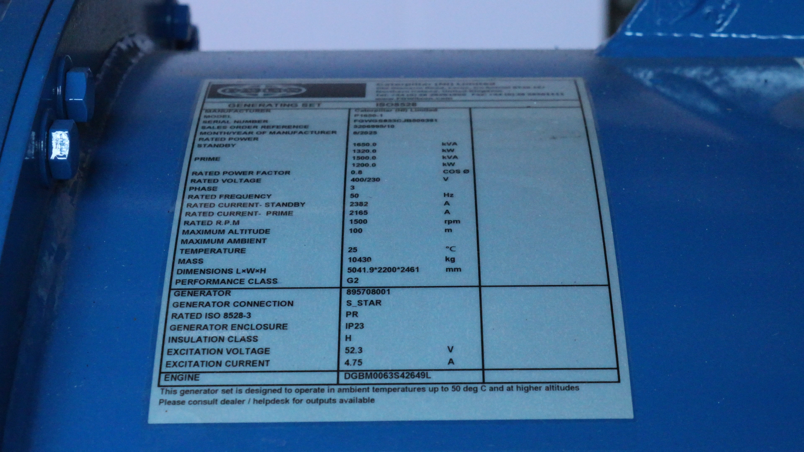
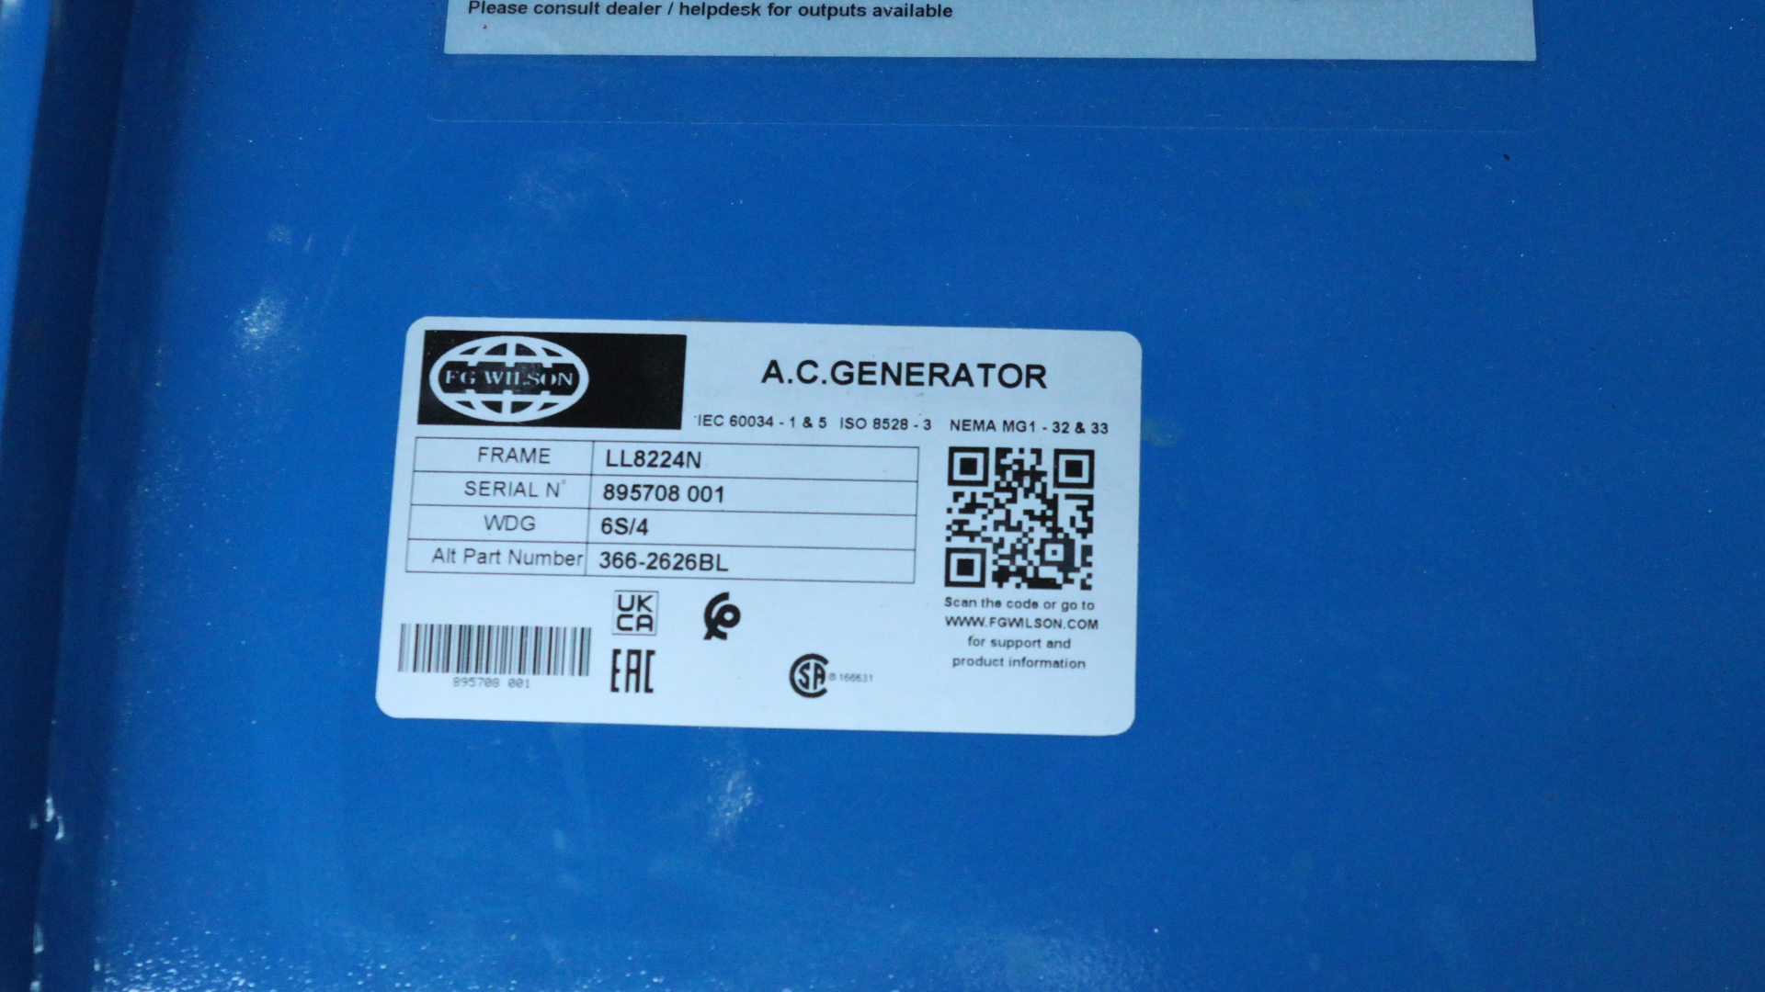
VWE: Morgan Sindall Construction – Day 2
Handout 1 – Generator task
Developing Experts Copyright 2026 All Rights Reserved

Slide 5
VWE: Morgan Sindall Construction – Day 2
Handout 1 – Generator task
Delivery inspection form
Site information
Project name: ______________________________
Site Address: ______________________________
Date of delivery: __________________________
Time of delivery: __________________________
Generator details
Generator make: __________________________
Serial number: ____________________________
Engine number: ___________________________
Mass: _____________________________________
Dimensions: _______________________________
Rated voltage: ____________________________
Check item: | OK ✓ | Not OK ✓ | Comments
No visible damage or scratches to paintwork
No oil, fuel or coolant leaks
Warning labels and signage present
Control panel undamaged
Cables secured safely
Developing Experts Copyright 2026 All Rights Reserved

Slide 6
VWE: Morgan Sindall Construction – Day 2
Handout 1 – Generator task
Damage or issues noted on delivery
(Include photos if possible)
Any further comments
Acceptance
Accepted on site: ☐ Yes ☐ No
Accepted with comments: ☐ Yes ☐ No
Signatures
Inspected by (name): _______________________
Position: _________________________________
Signature: ________________________________
Date: ____________________________________
Check item: | OK ✓ | Not OK ✓ | Comments
Exhaust system secured
No visible damage to panels or casing
Emergency stop button fitted and accessible
Developing Experts Copyright 2026 All Rights Reserved

