Slide 1


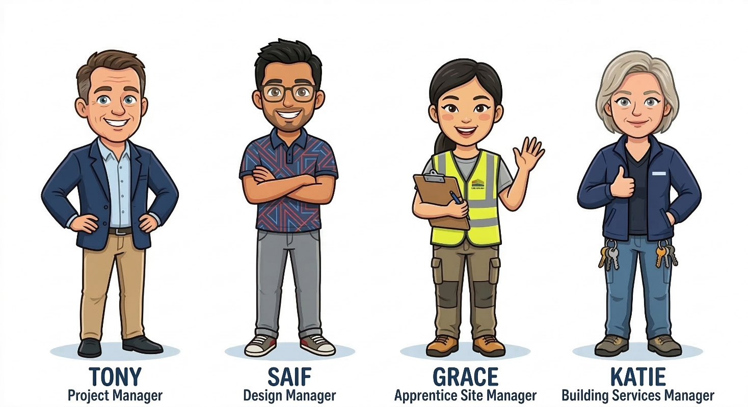
VWE: Morgan Sindall Construction – Project Day
Handout 5 – Engagement event
Read the full brief for the engagement day below. This will give you all the information you need. You will also have your own ideas – creativity is encouraged!
Number of students attending: 45
Number of staff attending: 5
Arrival time: 9:30 am
Departure time: 3 pm
Morgan Sindall Construction event lead: Monica Paul
Morgan Sindall Construction colleagues available to support on the day:
Your day could include a tour of the site (with a safety talk beforehand), talks by Morgan Sindall Construction colleagues, apprentice and career information, CV workshops, and different construction workshops. You need to think about the focus of each activity; what do you want each student to get from it? Think about who will lead each activity.
Use the support tool on the next page if you need further guidance and ideas for activities.
Each student does not need to complete every activity.
Developing Experts Copyright 2026 All Rights Reserved

Slide 2
VWE: Morgan Sindall Construction – Project Day
Handout 5 – Engagement event – Support tool
Here is a list of activities you could include in your engagement event schedule. Use your own ideas too!
Activity | What students would gain
Site safety briefing | Learn the importance of health and safety, PPE, and site rules.
Guided site tour | See how a real construction site operates and understand project stages.
Meet the project manager talk | Learn about leadership, planning, and managing construction projects.
Apprenticeship information session | Understand routes into construction careers and training opportunities.
CV writing workshop | Learn how to write a strong CV for jobs or apprenticeships.
Tool demonstration workshop | Learn how construction tools are used safely and correctly.
Bricklaying demonstration | Understand the techniques and skills involved in brickwork.
Timber frame workshop | Learn how timber structures are assembled and installed.
Surveying activity | Learn how measurements, levels, and site layouts are carried out.
Sustainability talk | Understand environmentally friendly construction practices.
Engineering challenge activity | Develop teamwork and problem-solving skills through a practical challenge.
Health and wellbeing session | Understand the importance of physical and mental wellbeing in construction.
Technology in construction talk | Learn how digital tools and modern technology are used on sites.
Reflection session | Reflect on what they learned and consider future career interests.
Q&A with construction staff | Gain insight into real experiences working in the industry.
Developing Experts Copyright 2026 All Rights Reserved

Slide 3
VWE: Morgan Sindall Construction – Project Day
Handout 5 – Engagement event
Use the timings below to schedule the day. This will be sent to the college before they attend.
Event schedule
09:30 - 09:45
______________________________________________________________________
09:45 - 10:00
______________________________________________________________________
10:00 - 10:45 Session 1
OPTION A: ___________________________________________________________
OPTION B: ___________________________________________________________
10:45 - 11:00 Break
11:00 - 11:45 Session 2
OPTION A: ___________________________________________________________
OPTION B: ___________________________________________________________
11:45 - 12:30 Session 3
OPTION A: ___________________________________________________________
OPTION B: ___________________________________________________________
12:30 - 13:00 Lunch
13:00 - 13:45 Session 4
OPTION A: ___________________________________________________________
OPTION B: ___________________________________________________________
13:45 - 14:30
______________________________________________________________________
14:30 - 14:50
______________________________________________________________________
14:50 - 15:00
______________________________________________________________________
Developing Experts Copyright 2026 All Rights Reserved

Slide 4
VWE: Morgan Sindall Construction – Project Day
Handout 5 – Engagement event – Challenge task
Use this page to prepare for the event. Make a to-do list of things to complete before the students arrive on site. Use the categories to guide you.
Category | Things to think about | To do list/notes
Health and safety | What do you need to do before the event to ensure everyone on site will be safe? Think about PPE for the students, emergency contact details, clear walk routes, and no access areas.
Resources | What do you need to buy or source before the day?
Developing Experts Copyright 2026 All Rights Reserved

Slide 5
VWE: Morgan Sindall Construction – Project Day
Handout 5 – Engagement event – Challenge task
Category | Things to think about | To do list/notes
Roles and responsibilities | Who will do what on the day? Who will lead each workshop? Who is responsible for what? How will you communicate with them?
Data to capture | What would you like to find out following this event? Think about the number of students who attended, their interests and next steps.
Post-event follow-up actions | What will you do after the event to make sure students stay engaged with the project?
Developing Experts Copyright 2026 All Rights Reserved

